Slide 1
New Features
Last Thursday - 2pm Central
A Look Into Ever-Evolving Touchpoint Solutions

Slide 2
Presenters
Andrew Triplett Director of Consulting | Chris Dolan Vice President, Product & Strategy

Slide 3
Housekeeping
Submit Questions using Q&A Button in Control Panel

Slide 4
Agenda
Web
Mobile
Future Updates

Slide 5
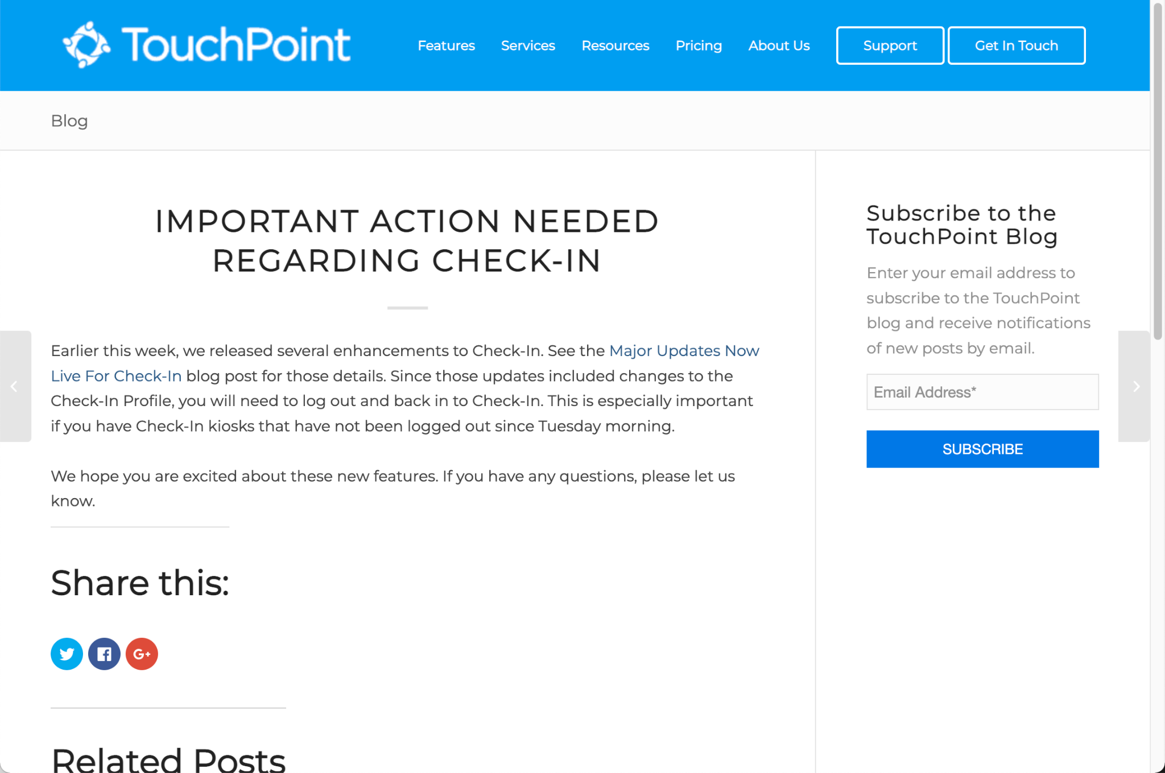
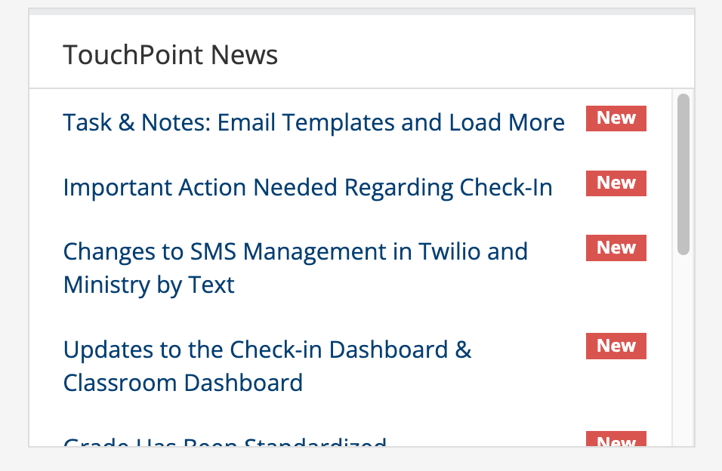
Subscribe!
https://www.touchpointsoftware.com/subscribe-to-blog

Slide 6
Web Features

Slide 7
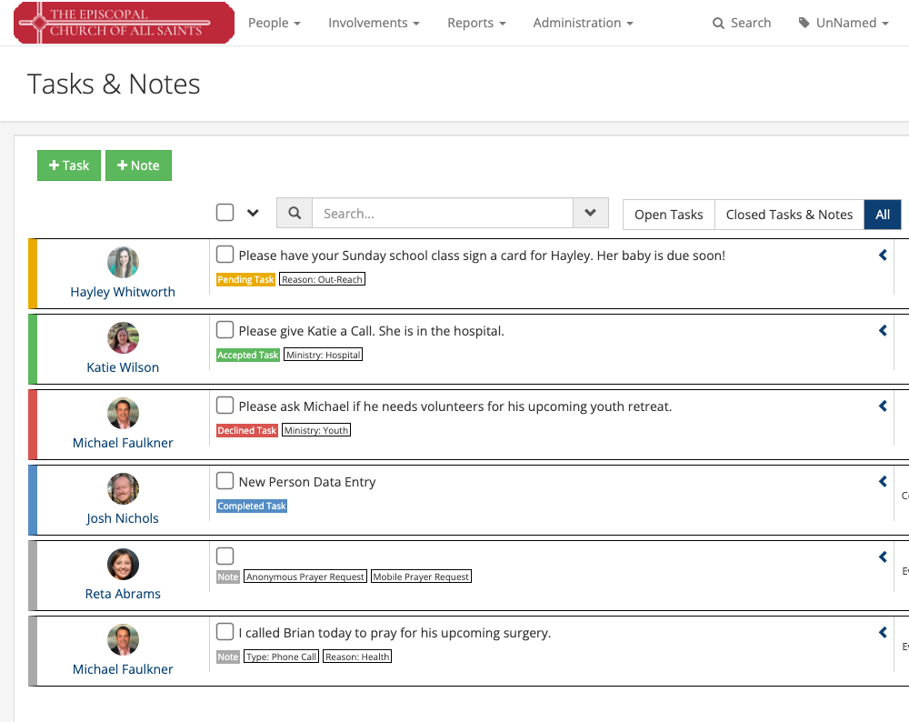
Tasks & Notes
Customize Email Templates
Advanced Search
Load More
Keyword Extra Questions
Search Builder Conditions
More…
Notes:
CD Task and Note Email Templates

Slide 8
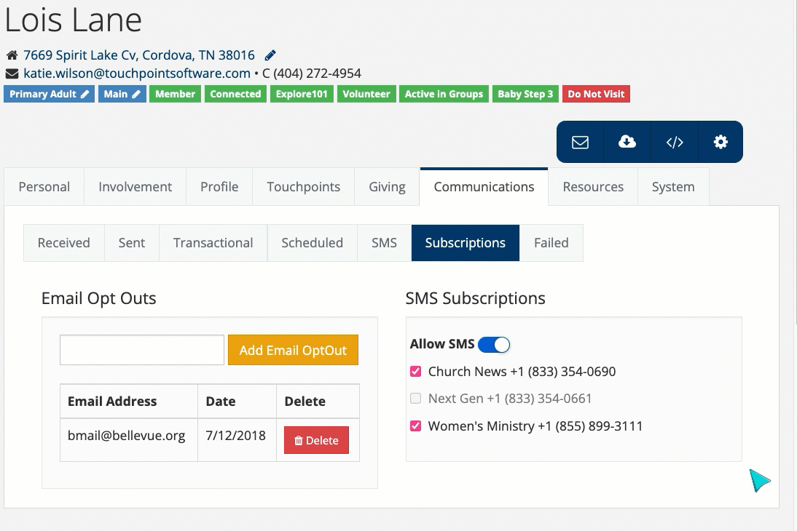
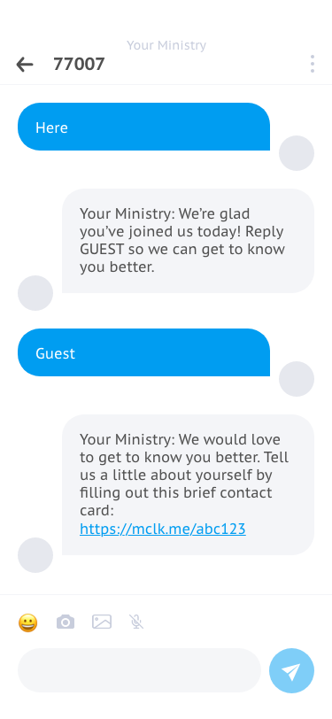
SMS Updates
New Integration:
Notes:
Ministry By Text (MBT) Integration (CD)
SMS Updates (MBT & Twilio)

Slide 9
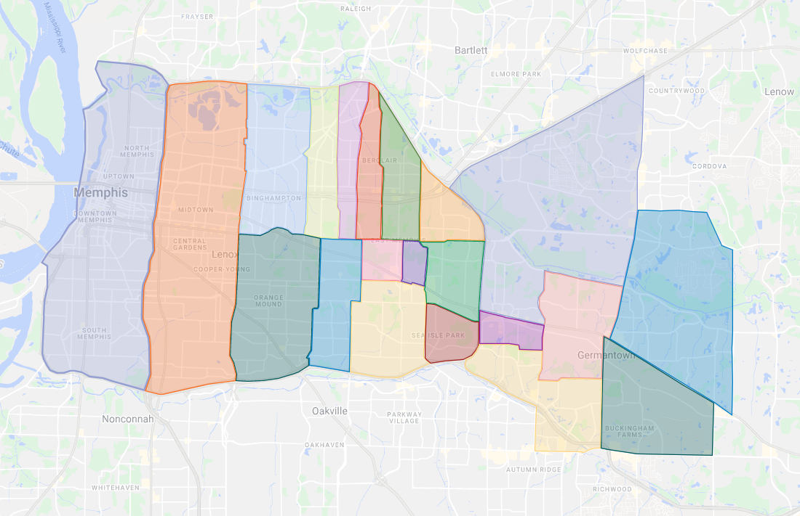
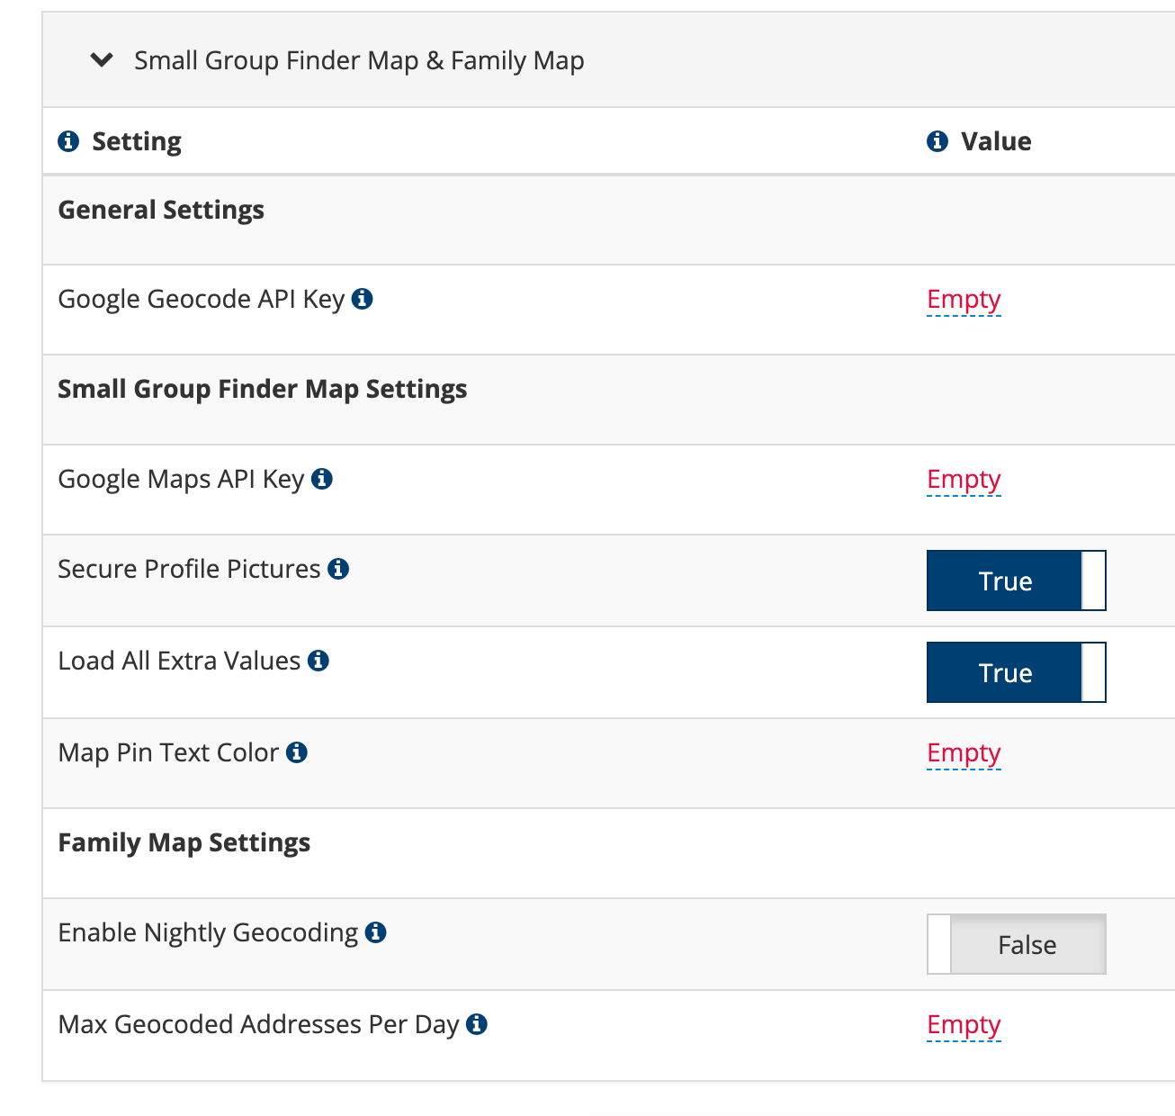
Geographic Regions
Notes:
(AT)

Slide 10
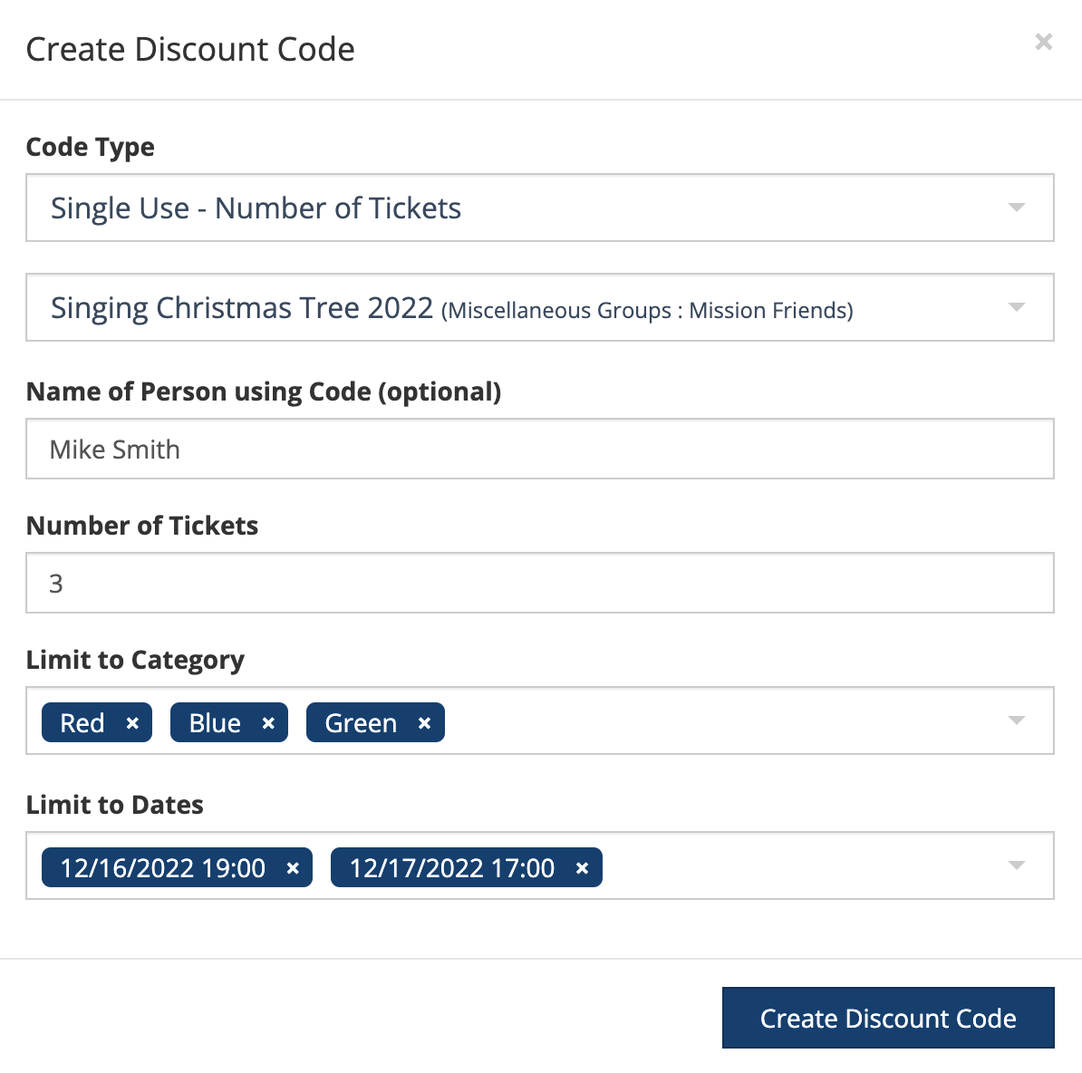
Ticketing Updates
Notes:
(AT)

Slide 11
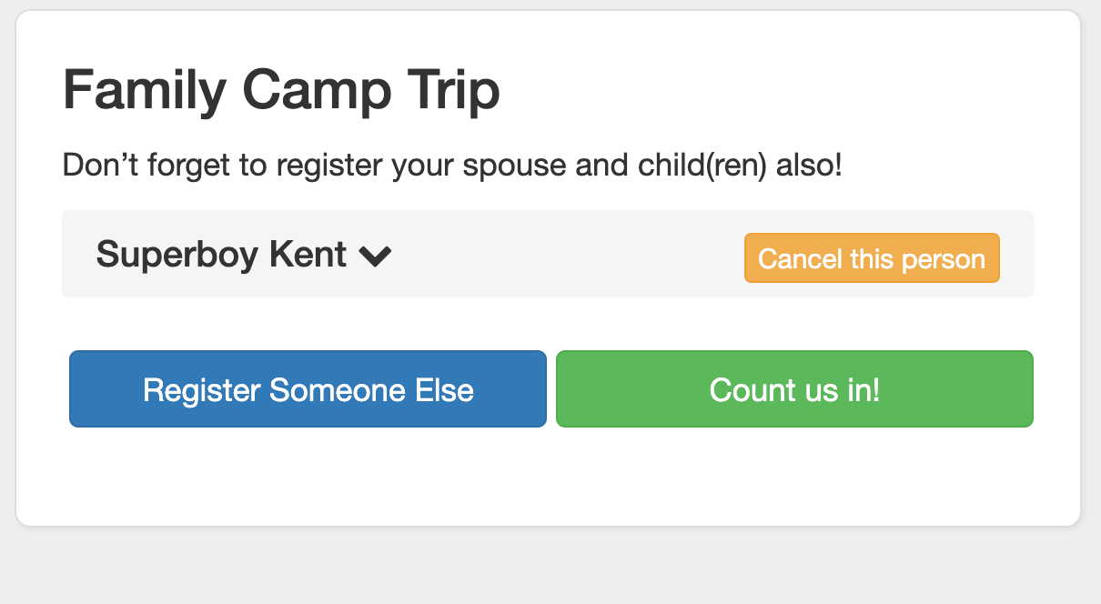
Custom “Submit” Button in Registrations
Notes:
(AT)

Slide 12
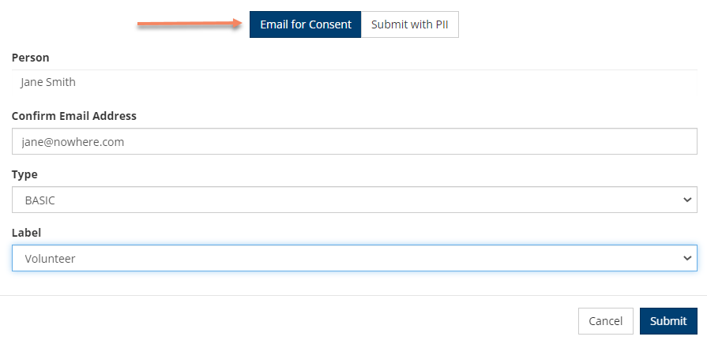
Background Checks
Notes:
CD

Slide 13
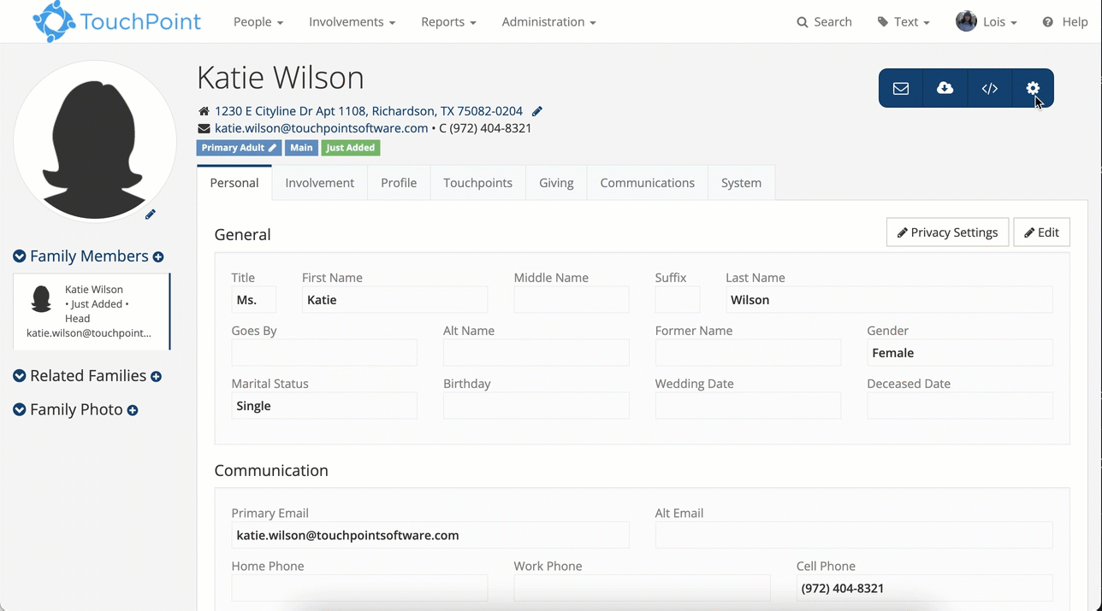
Merge Controller
Notes:
CD

Slide 14
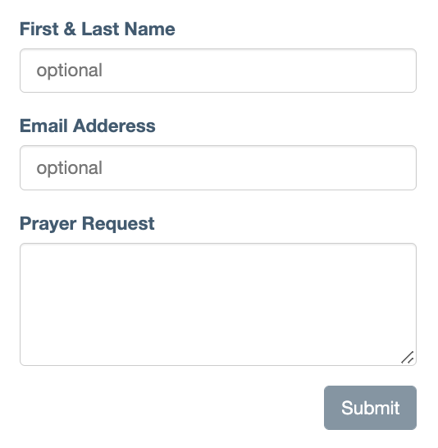
Prayer Request Form
Notes:
CD

Slide 15
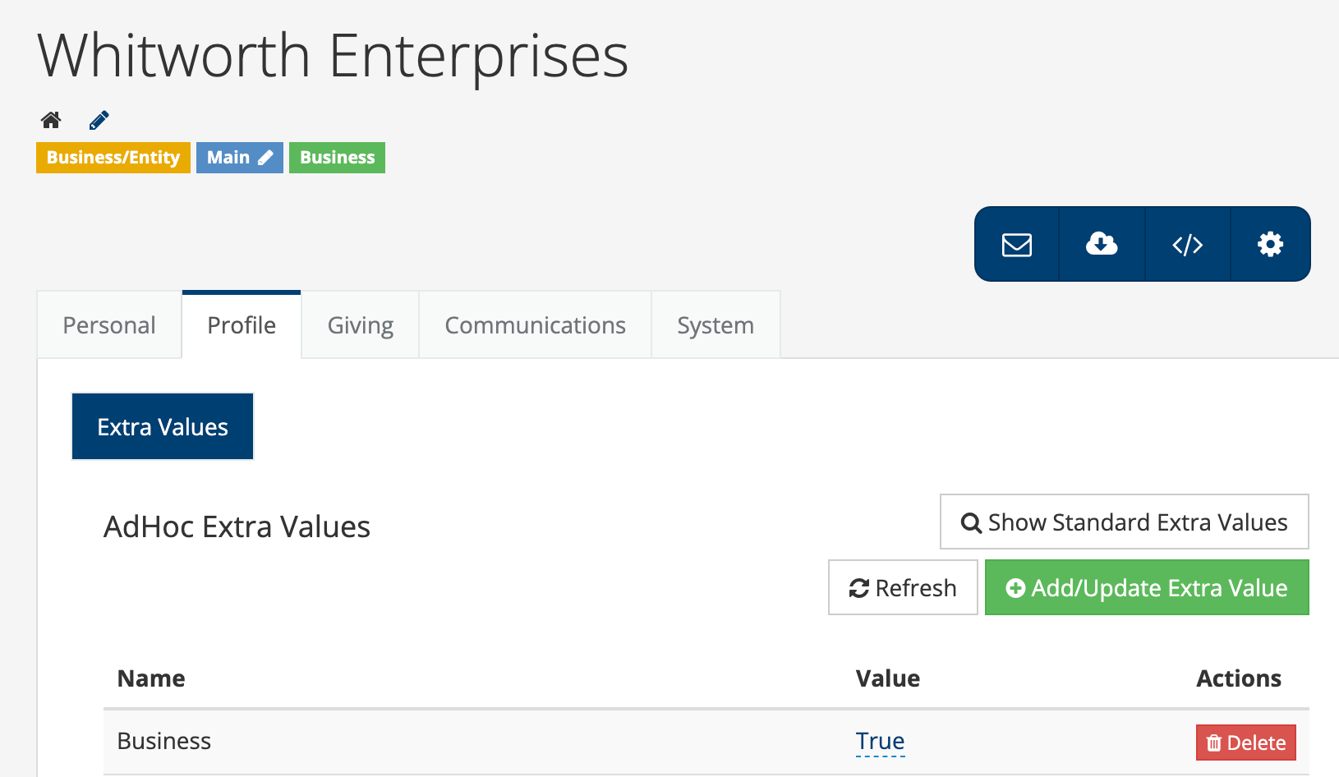
Extra Values for Business Profiles
Notes:
CD

Slide 16
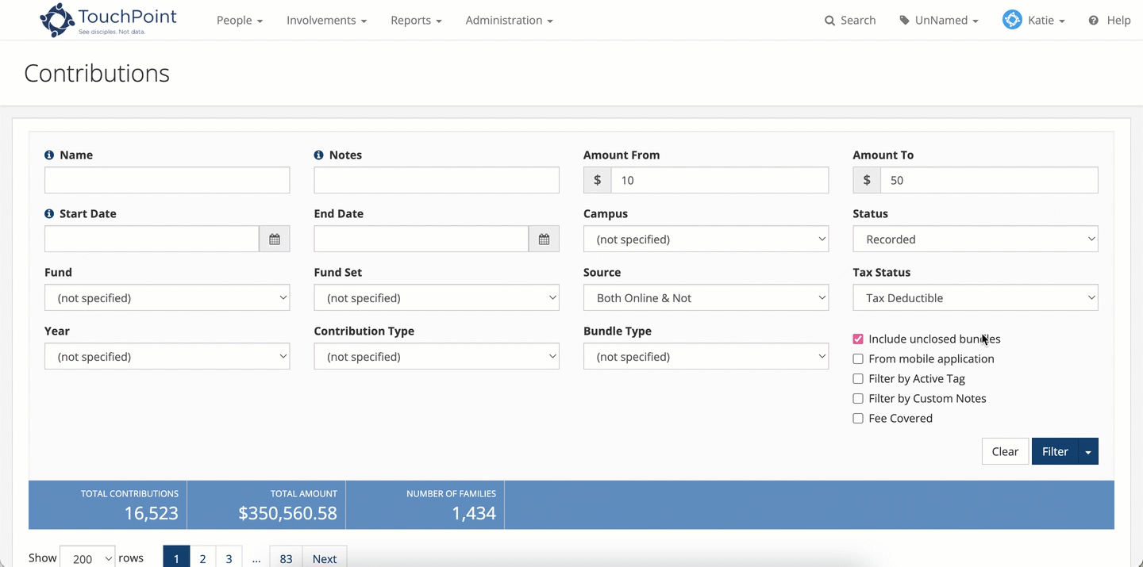
Contribution updates
Notes:
CD
Mass Update Contributions
Contributions Search Export
Bundles Page - we added a Reference ID
One-Time Giving - setting to expand Notes field by default
Recurring Giving - edit their recurring gift, both for the Fund and amount

Slide 17
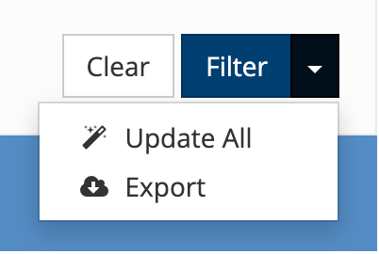
Contribution Search Export
Notes:
CD
Mass Update Contributions
New Failed Gift Task
Contributions Search Export
Bundles Page - we added a Reference ID
One-Time Giving - setting to expand Notes field by default
Recurring Giving - edit their recurring gift, both for the Fund and amount

Slide 18
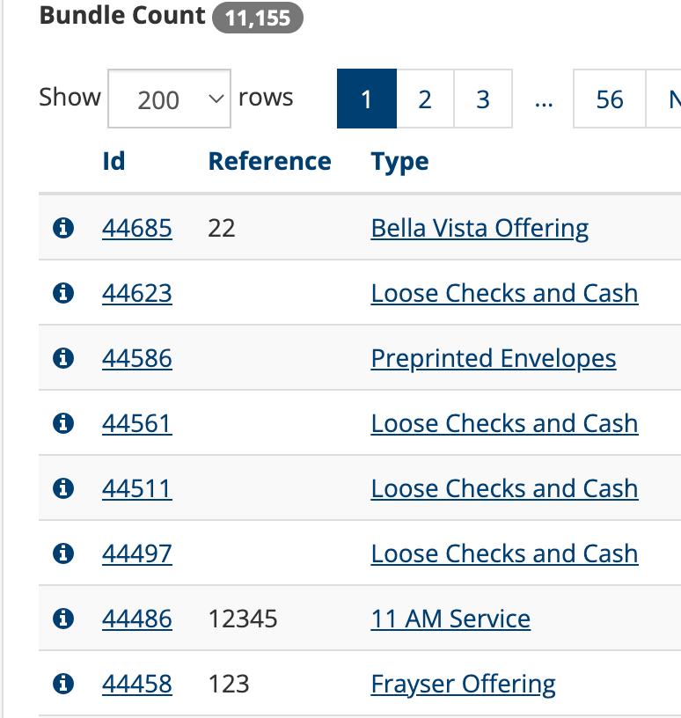
Contribution updates
New Failed Gift Task
Bundles Reference ID
Notes:
CD
Mass Update Contributions
New Failed Gift Task
Contributions Search Export
Bundles Page - we added a Reference ID
One-Time Giving - setting to expand Notes field by default
Recurring Giving - edit their recurring gift, both for the Fund and amount

Slide 19
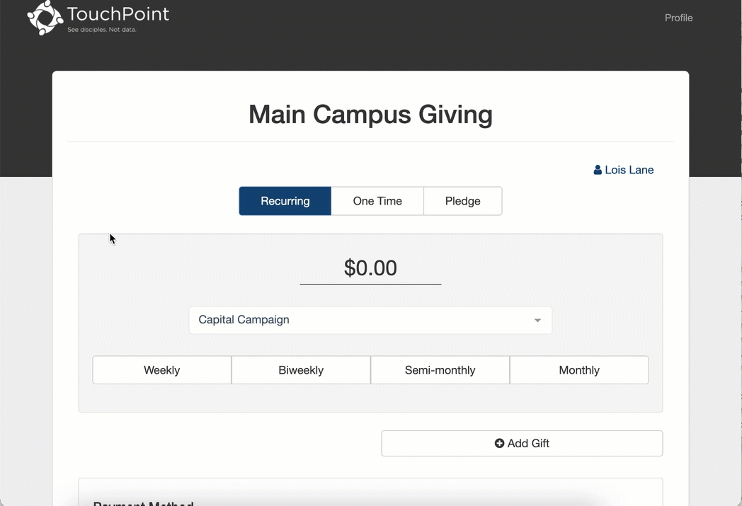
Edit Recurring Giving
Notes:
CD
Recurring Giving - edit their recurring gift, both for the Fund and amount

Slide 20
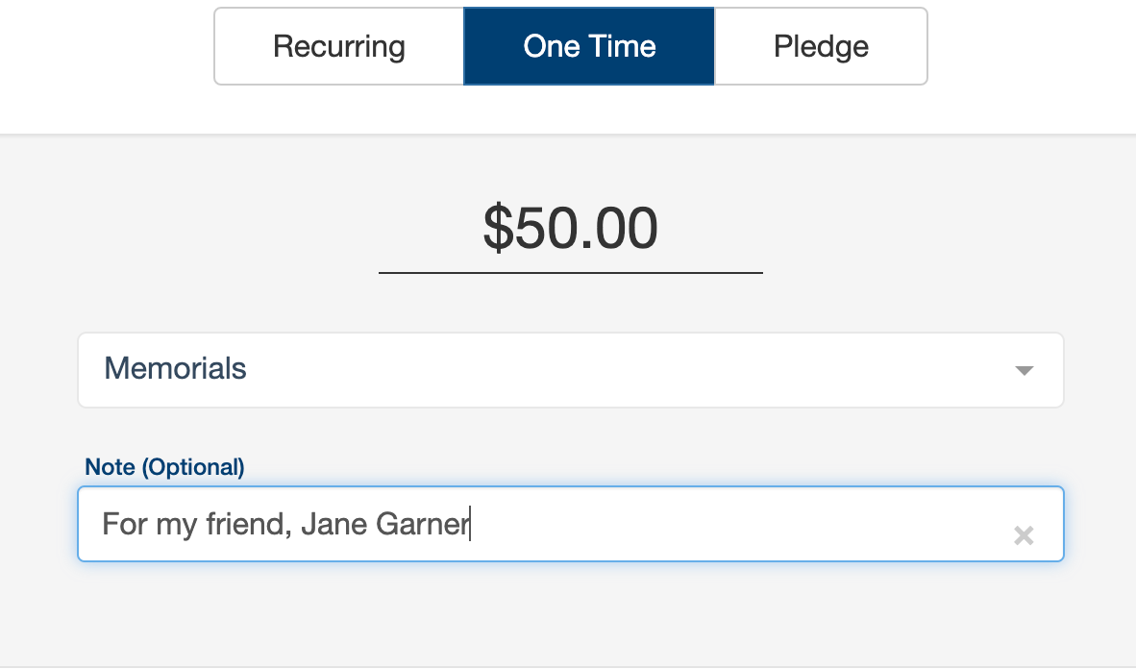
Notes Field
Notes:
CD

Slide 21
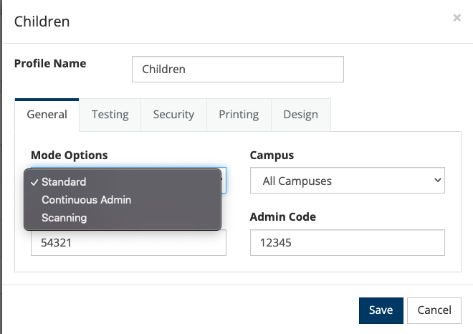
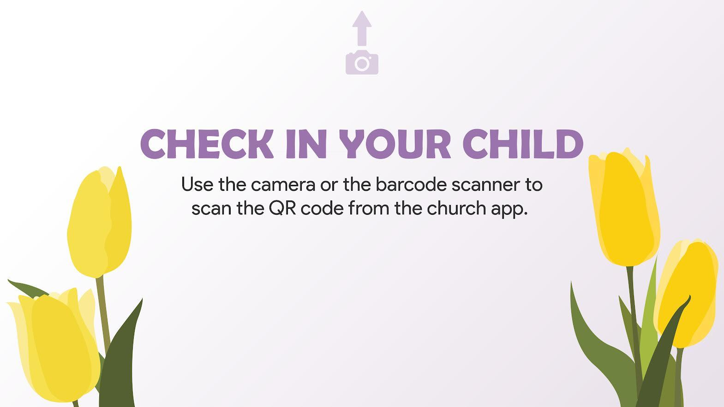
Check-In Profiles
Notes:
(AT)

Slide 22
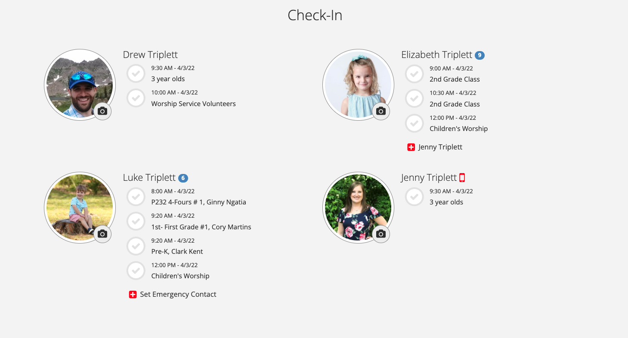
Check-In Updates
Notes:
(AT)

Slide 23
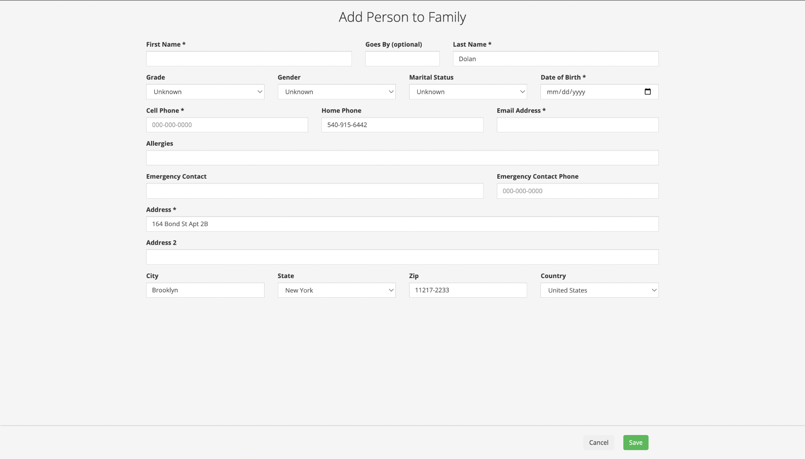
Check-In Updates
Notes:
(AT)

Slide 24
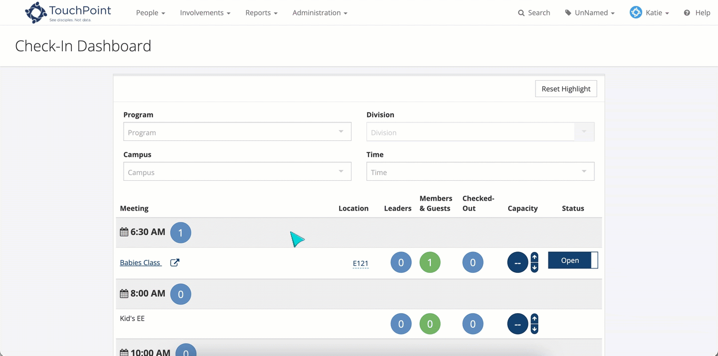
Check-In Dashboard
Notes:
(AT)

Slide 25
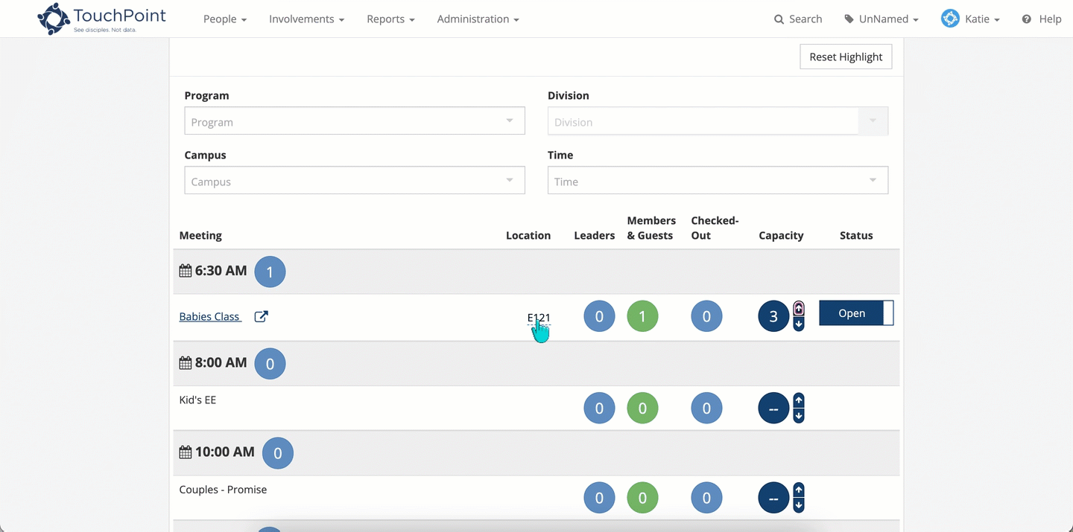
Classroom Dashboard
Notes:
(AT)

Slide 26
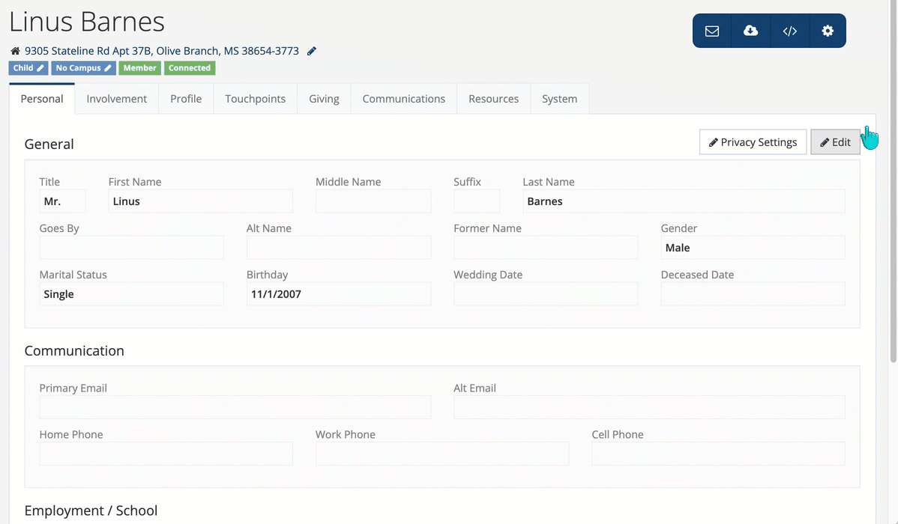
Standardized Grade
Notes:
(AT)

Slide 27
Mobile App

Slide 28
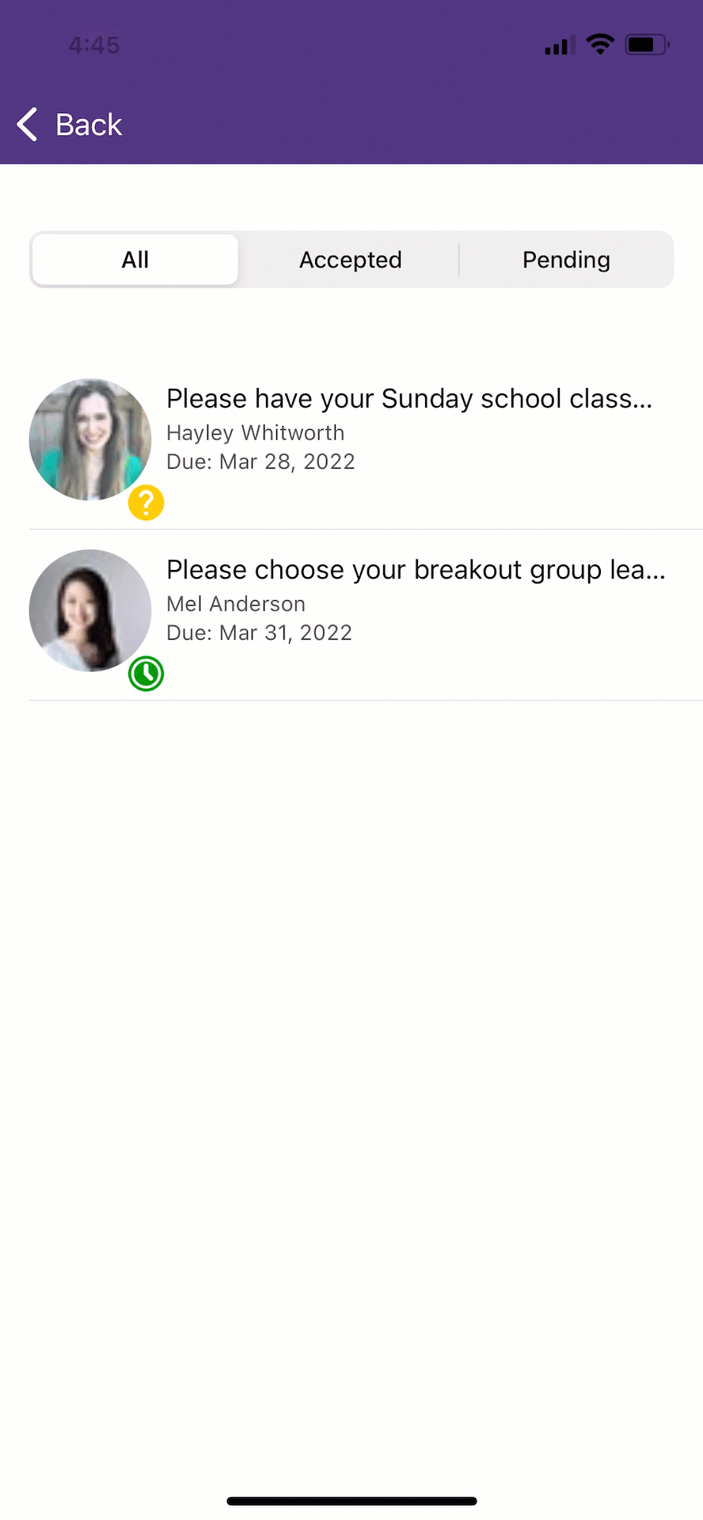
View Person Details in Tasks
Notes:
(AT) long press.

Slide 29
Event Tickets Available for Ticket Holders
Notes:
(AT)

Slide 30
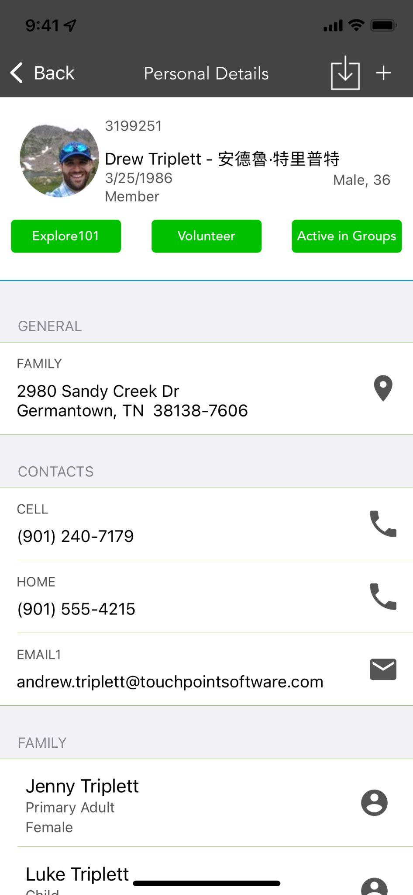
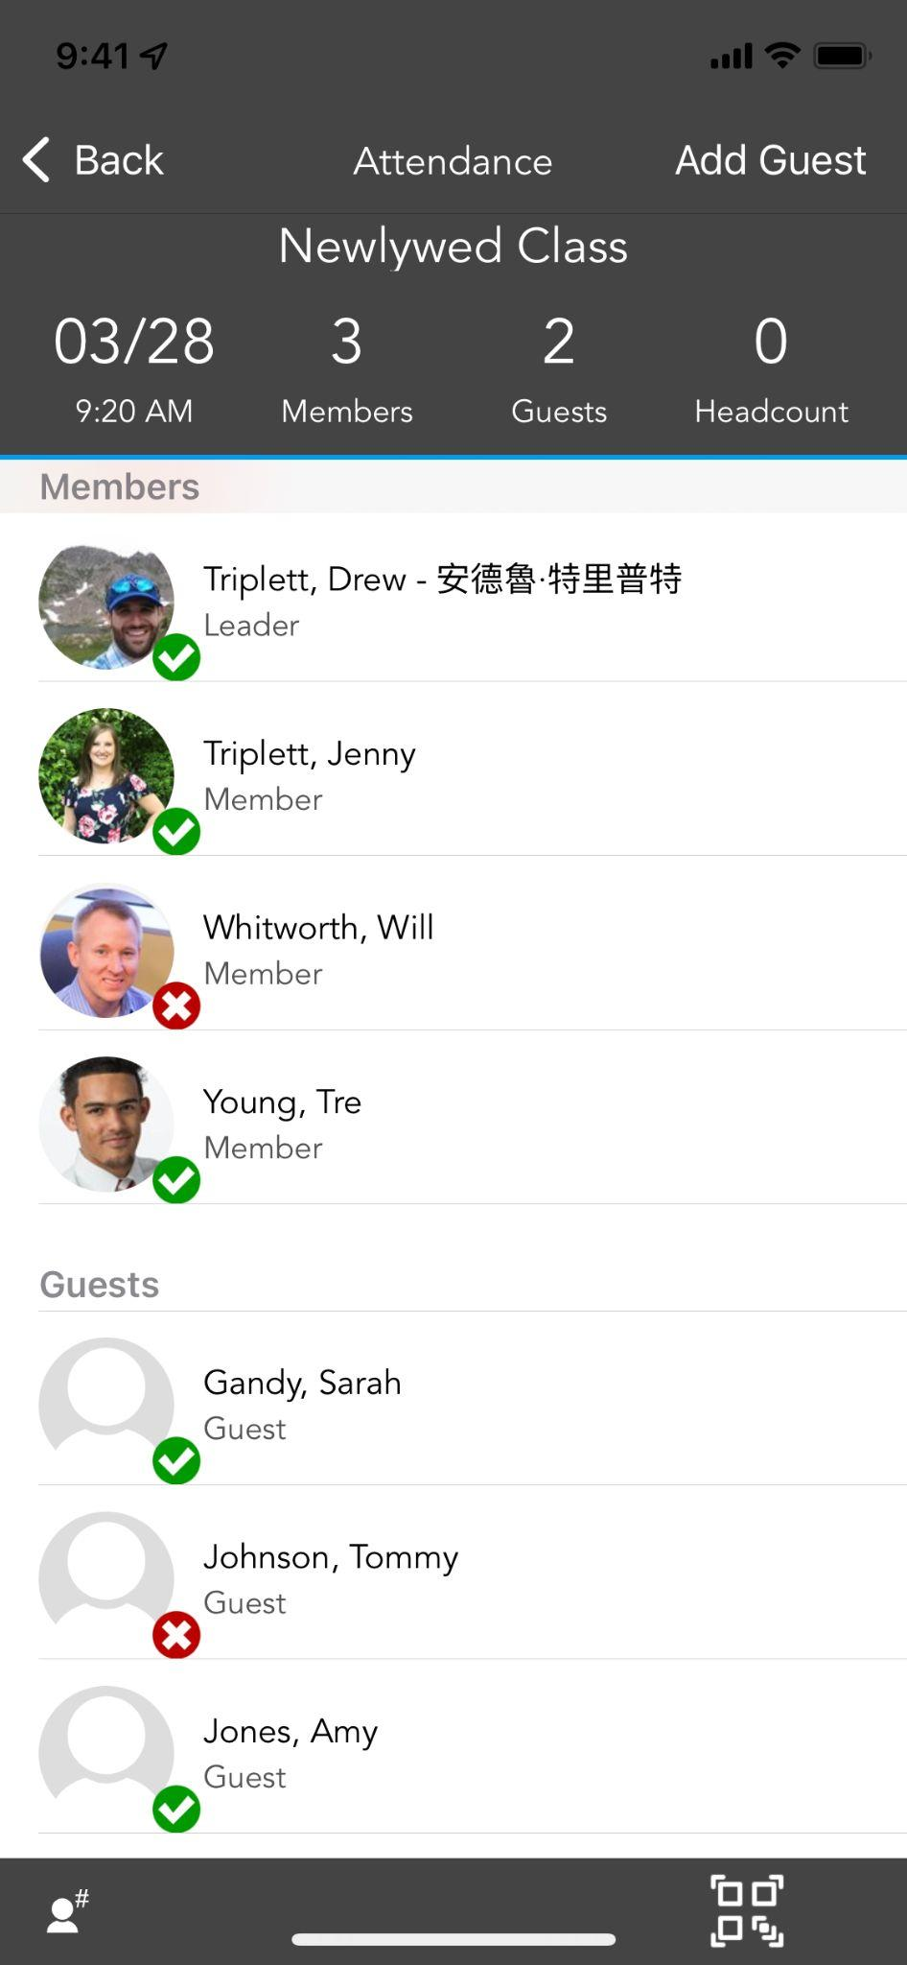
Alt Name
Notes:
(AT)

Slide 31
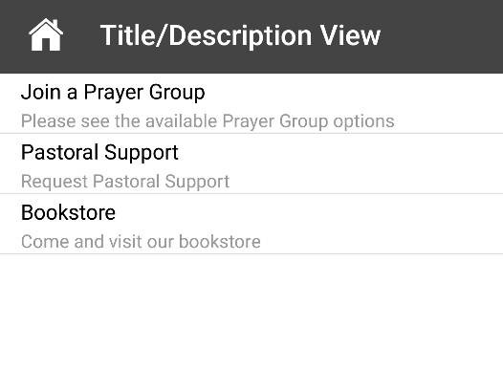
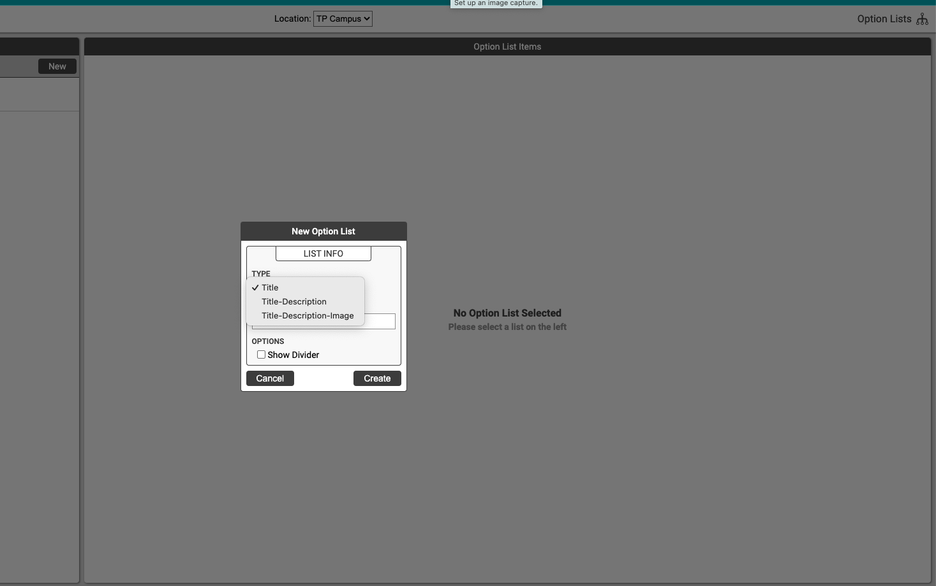
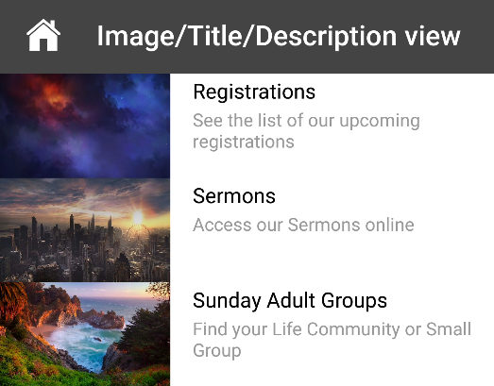
New Options Lists
Notes:
CD
There are now two additional options for lists:
Title & Description
Image, Title & Description
Both of these options are available with or without divider lines. These will help to include additional information in your Options Lists, and adding the image will make them come to life in the app. In the screenshots below, you will see an example of Title/Description with a divider and the Image/Title/Description screen.

Slide 32
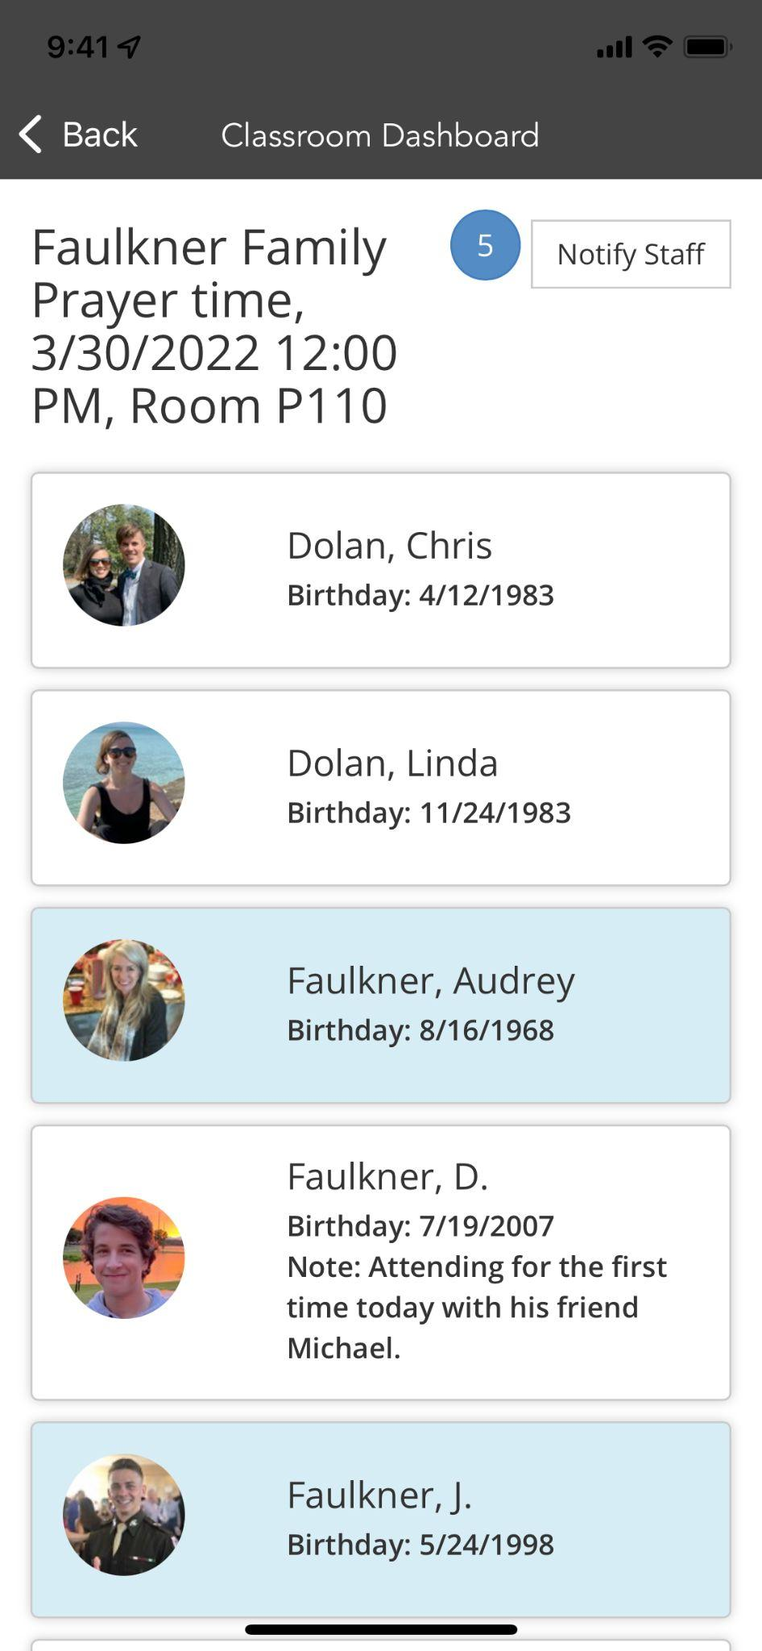
Classroom Dashboard
Notes:
CD

Slide 33
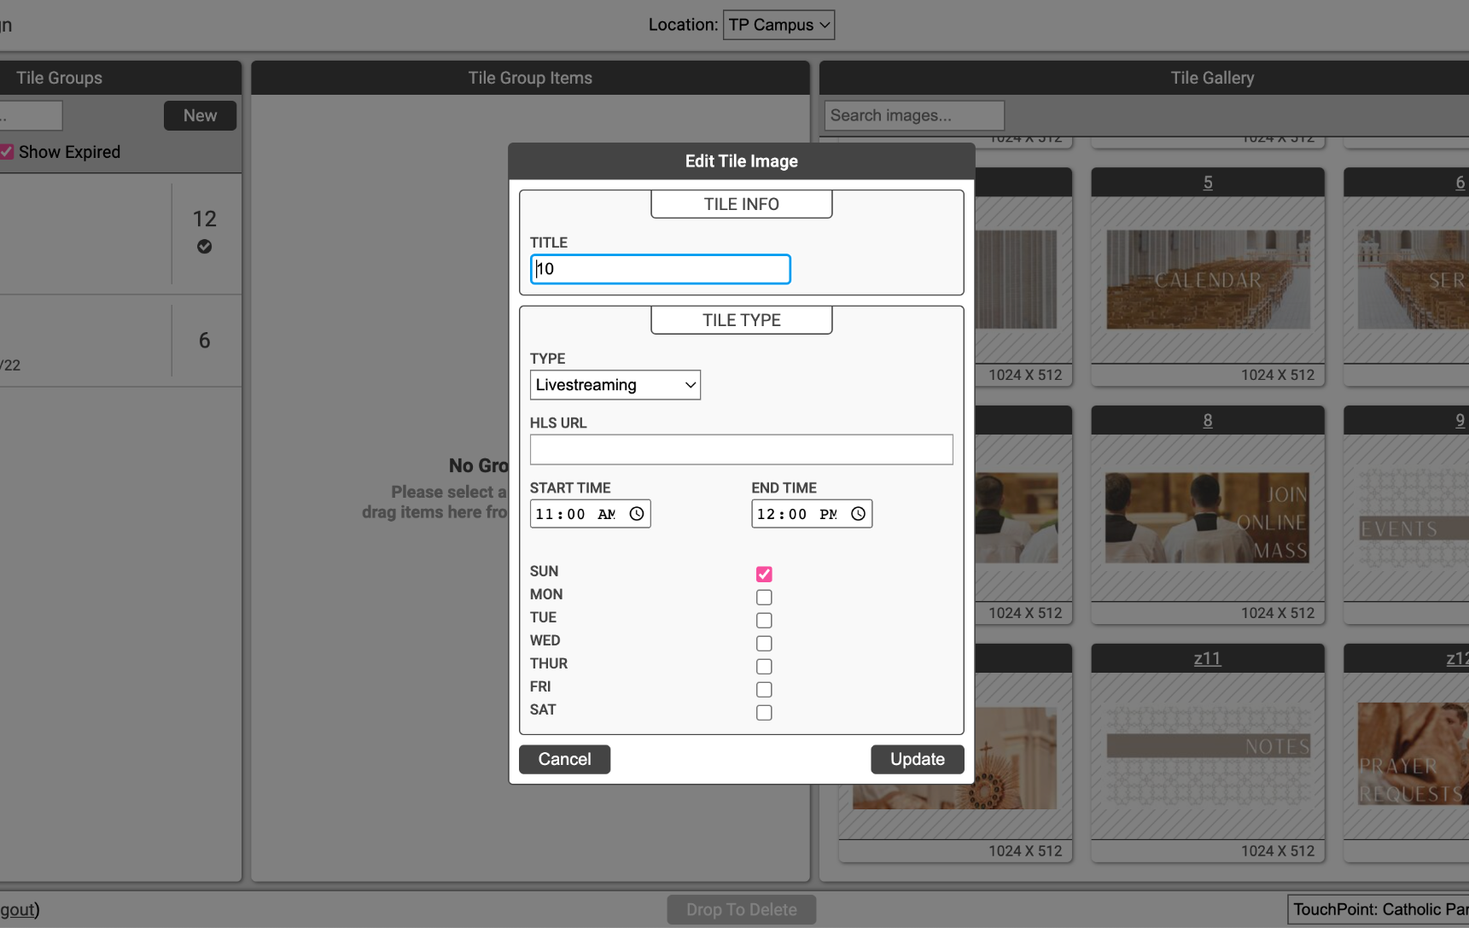
Native Live Streaming
Notes:
CD

Slide 34
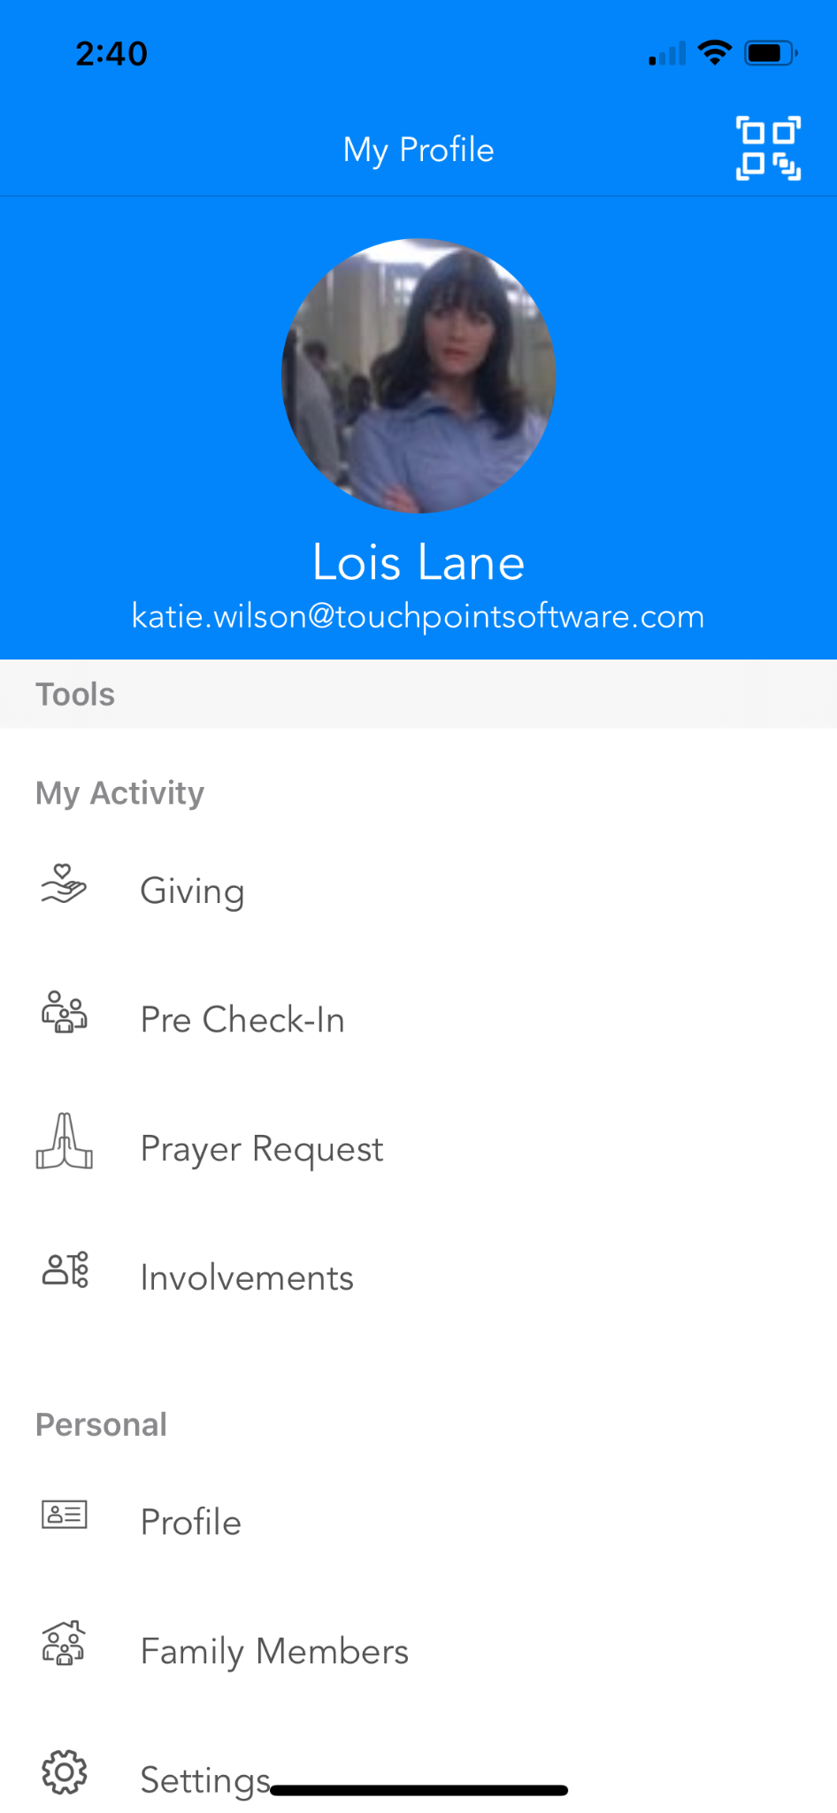
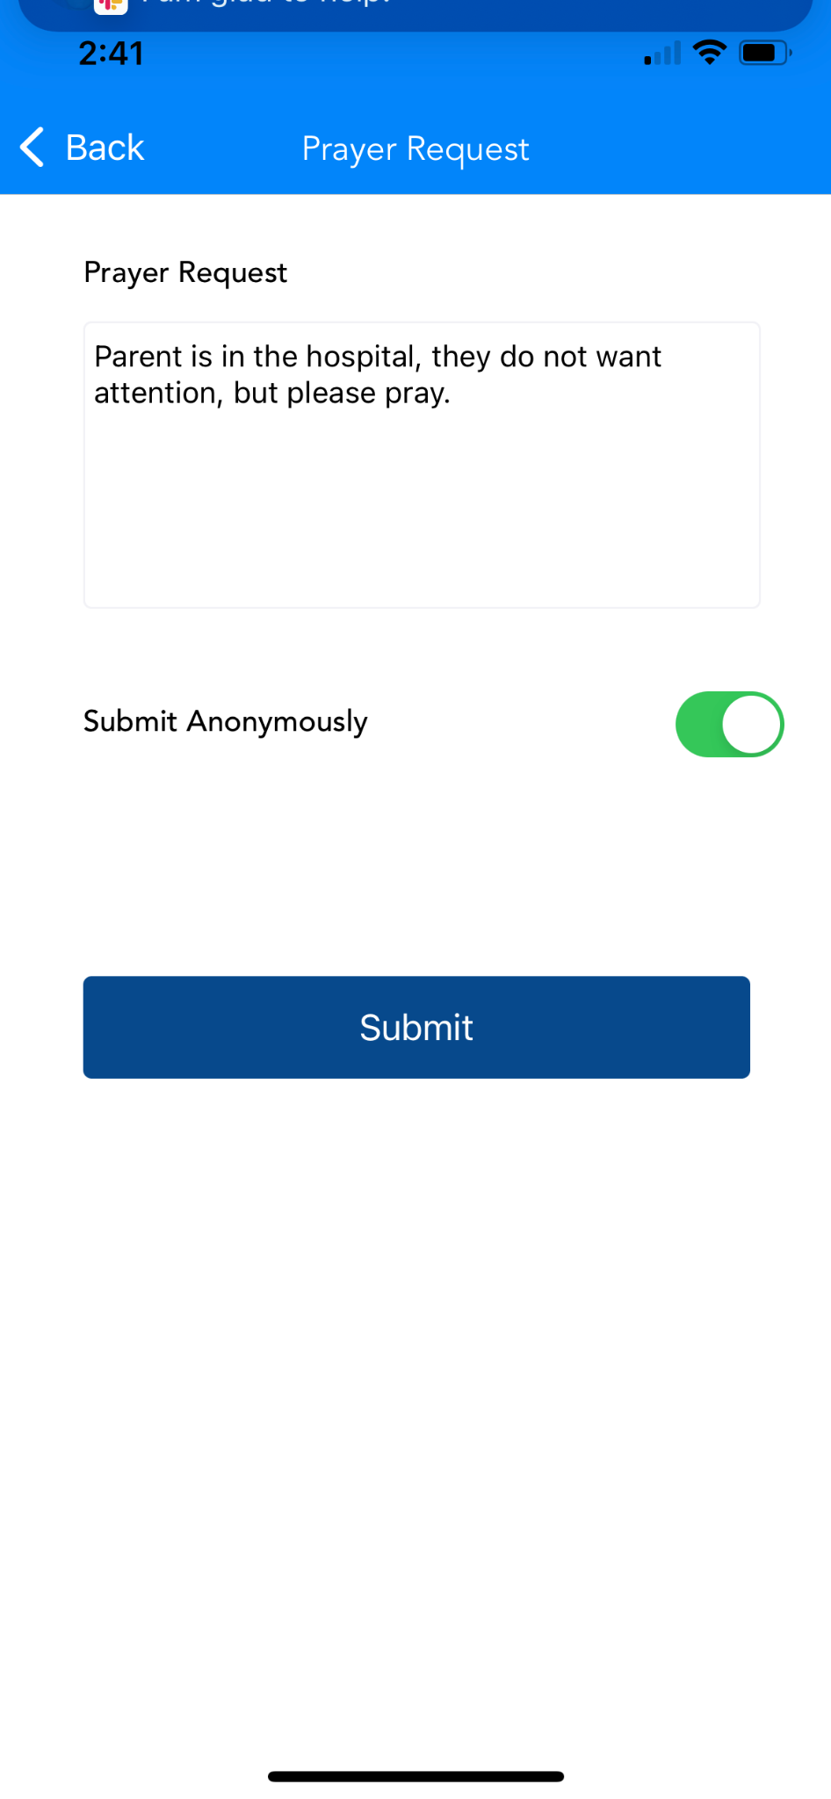
Prayer Requests

Slide 35
Future

Slide 36
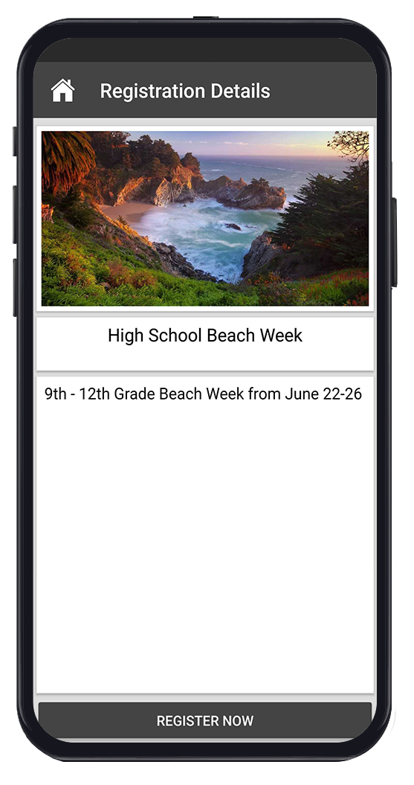
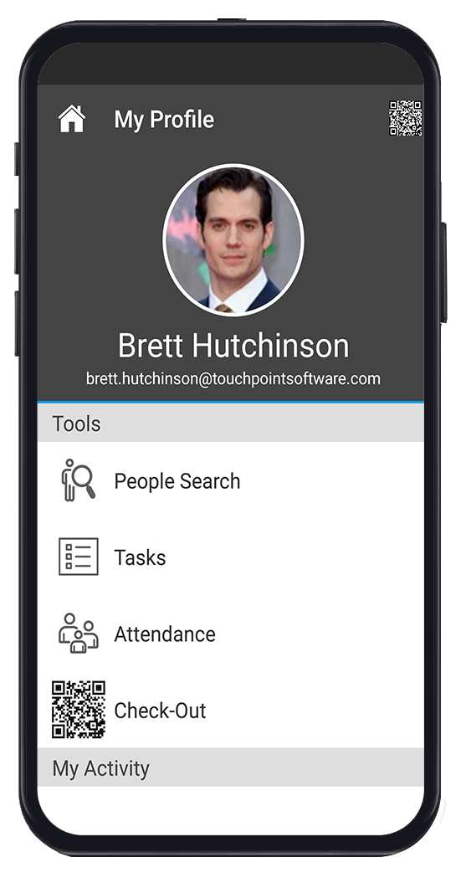
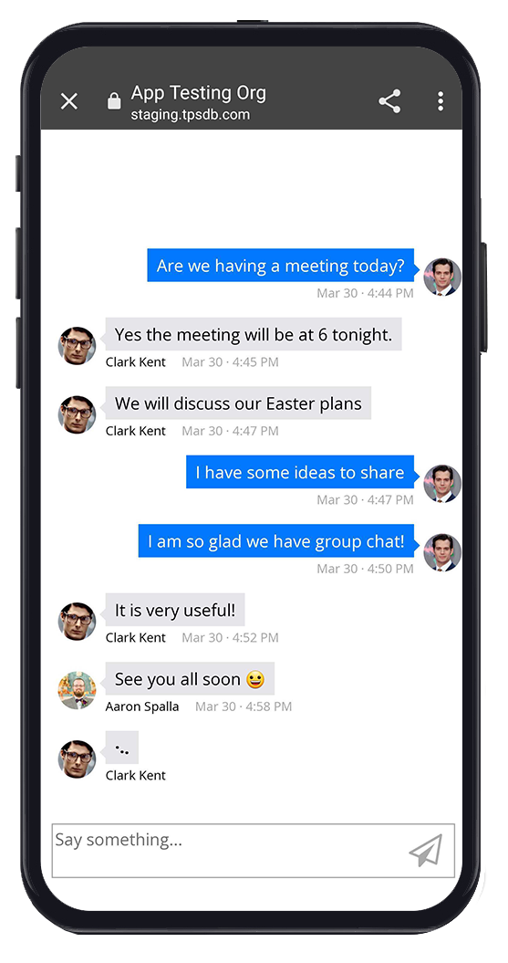
Next App Release
In App Video (HLS/MP4)
New deeplinks
Campus on profile
Volunteer scheduler
New Grade
Registration Tiles
Check-Out
Group Chat (beta)
Notes:
CD
Supporting in app media player - HLS/mp4 video files
Check out
New deeplinks - pre check-in & prayer requests
Campus on profile (optional)
Group Chat (beta)
Volunteer scheduler (beta)
New Registration Tile layout

Slide 37
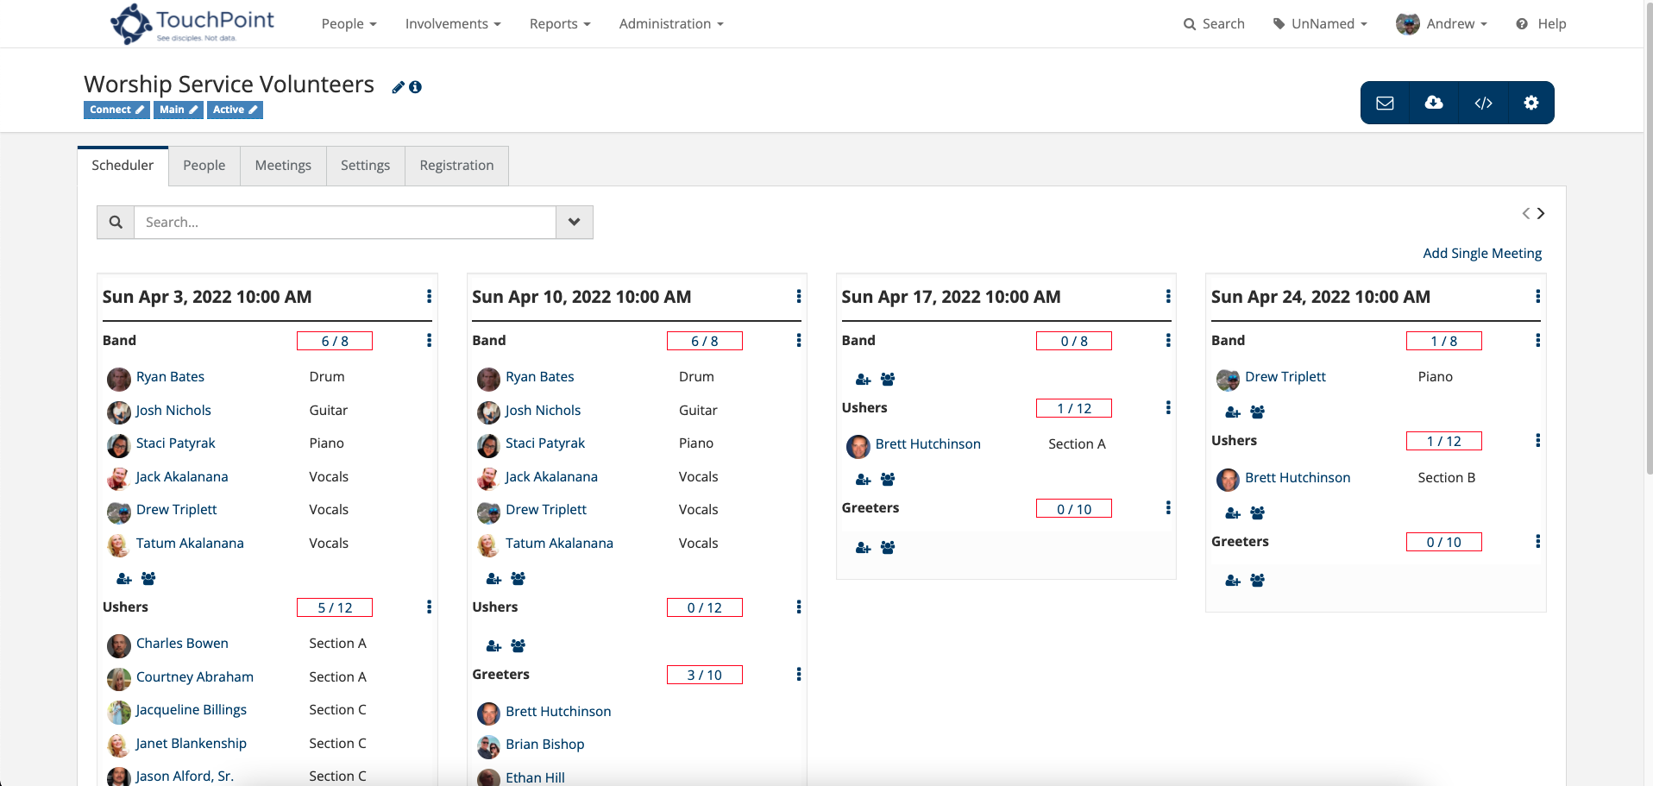
Volunteer Scheduler

Slide 38
Check-Out

Slide 39
One Page Forms

Slide 40
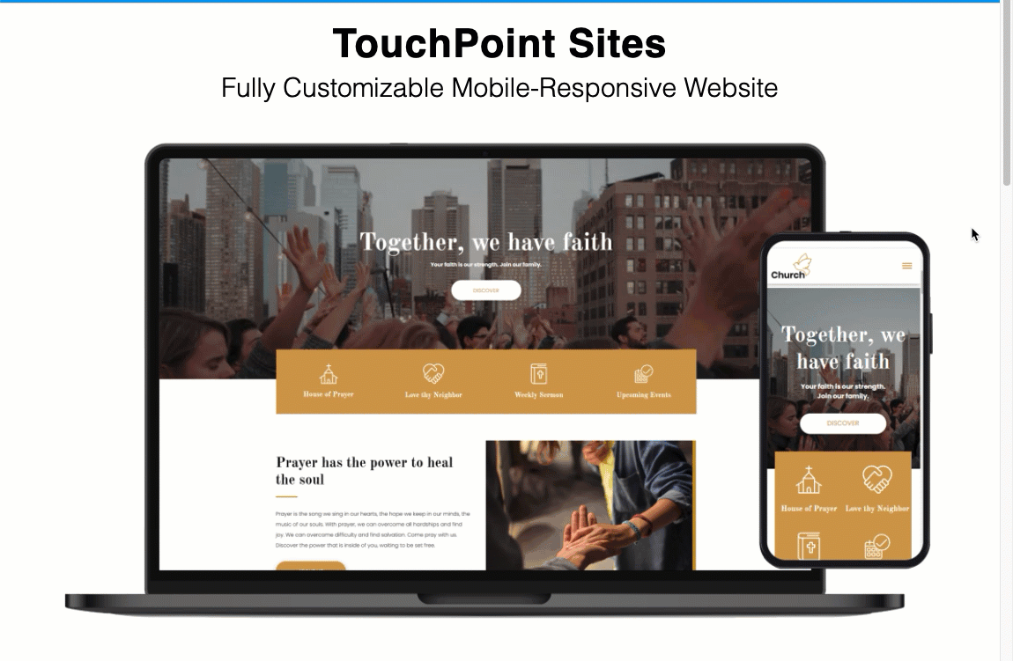
Sites

Slide 41
Future - In Development
Status Flags & Engagement Scores
Ministry Safe Integration
Process Builder & Automations
more…
Notes:
CD

Slide 42
touchpointsoftware.com • 1-888-788-6348

