Slide 1


What’s the Point…
of Branding?
Thursday, May 27th - 2pm Central
Making Ministry Easy With TouchPoint’s Solutions

Slide 2



Presenters
Andrew Triplett Director of Consulting | Michael Faulkner Vice President, Solutions

Slide 3


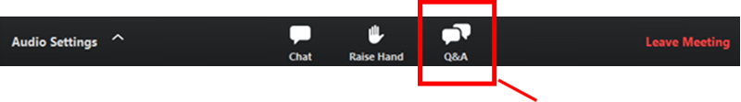
Housekeeping
Submit Questions using Q&A Button in Control Panel

Slide 4

Agenda
The Importance of Branding
How to Build a Recognizable Brand
Telling Your Story

Slide 5
The Importance of Branding

Slide 6









Why Brand?
Branding is used to create and cultivate an instant visual recognition.
It’s the easiest way to differentiate your church from others.

Slide 7


Why is Brand Identity Important?
Language
Shape
Color
Imagery
Typography
Icons

Slide 8
How to Build a Recognizable Brand

Slide 9

Building a Brand Kit
Brand kits are the easiest way to ensure your brand stays consistent, no matter who is helping share your story.

Slide 10

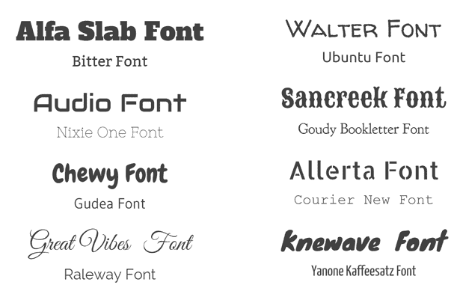

Building a Brand Kit
Three Main Components:
Color Scheme
Logo
Font

Slide 11
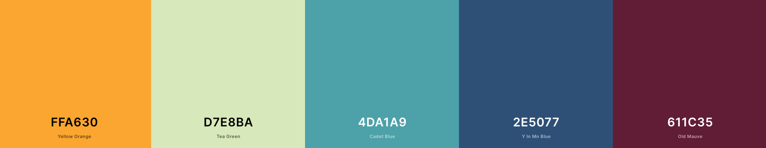
Choose Your Church Colors

Slide 12








Logos
Your Logo is your #1 brand identifier. It communicates ownership and gives anybody an instant idea of what you do.

Slide 13

Font Selection
Different fonts have different personalities and what you choose creates a brand experience for the end user.
Helvetica
Courier
Montserrat
Arial
Lobster
Notes:
https://www.columnfivemedia.com/how-to-find-brand-typography

Slide 14
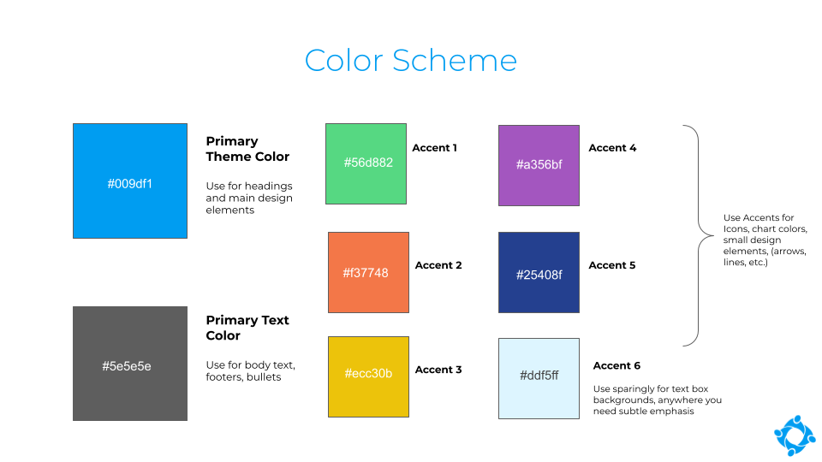
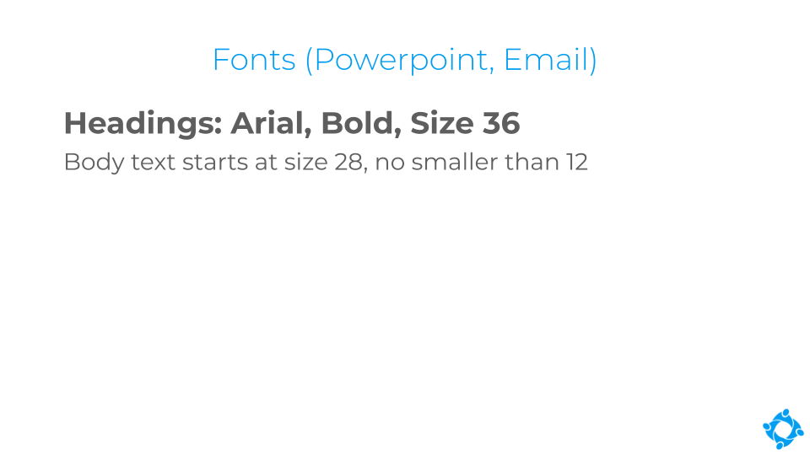
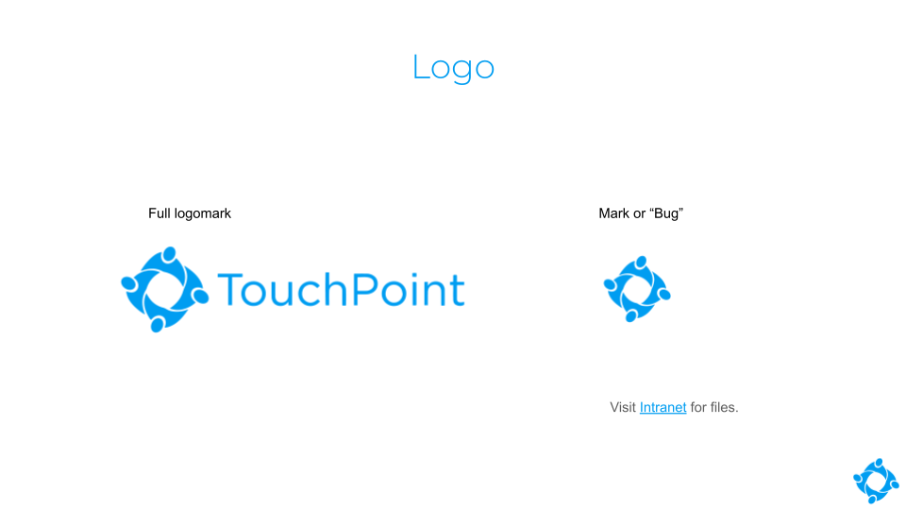
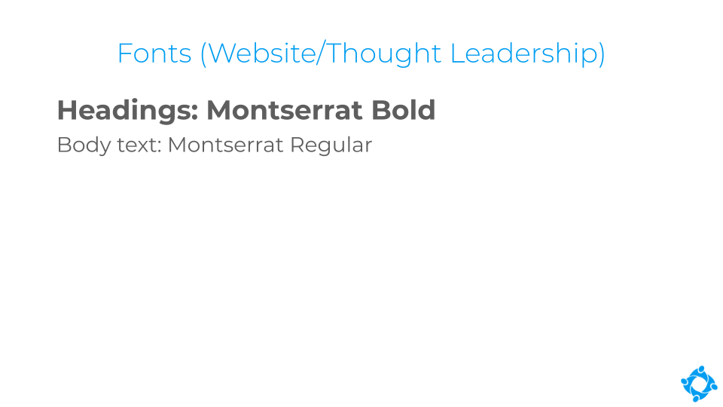
Your Final Kit
Notes:
Abundant Life Style Guide: https://livingproof.co/content/uploads/2020/06/AL_BrandStyleGuide.pdf

Slide 15



Select Graphics
Take “stock” Images of your Church. Create a folder of photos you can use at any time to help keep your brand consistent.
Notes:
Utilize Unsplash to help inspire or use some of their offerings!

Slide 16
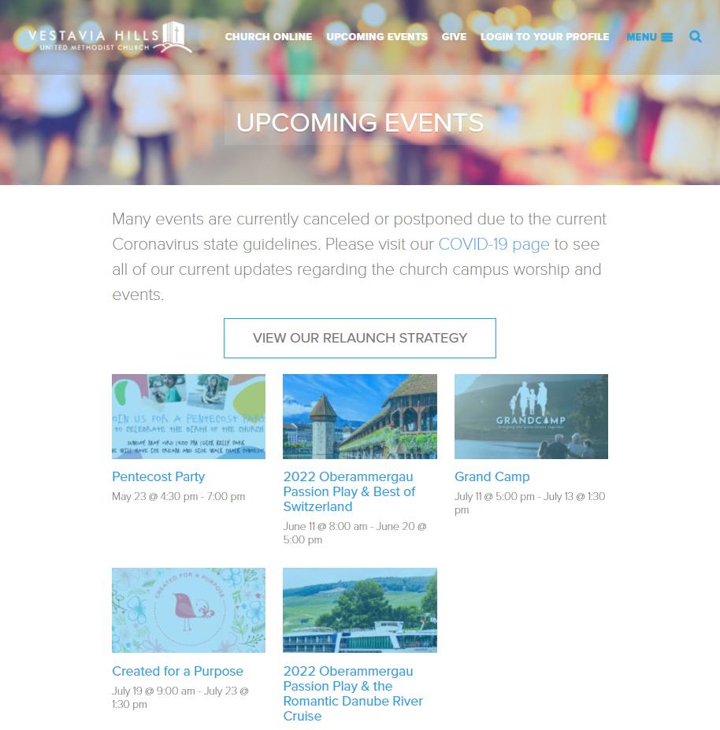
Pull It All Together

Slide 17
Telling Your Story

Slide 18

Make TouchPoint An Extension Of Your Church
Brand TouchPoint
Familiarity to Staff and End Users
Instill Trust in ChMS
Create More Positive Experience

Slide 19

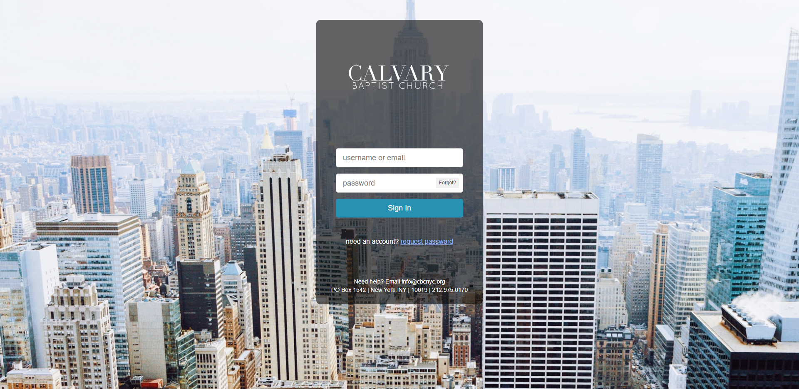
Login Page

Slide 20
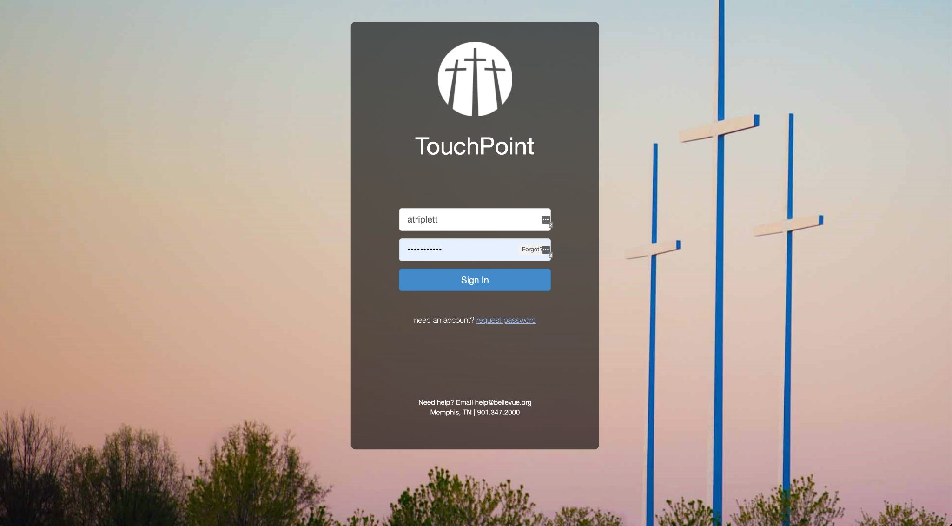
Login Page

Slide 21
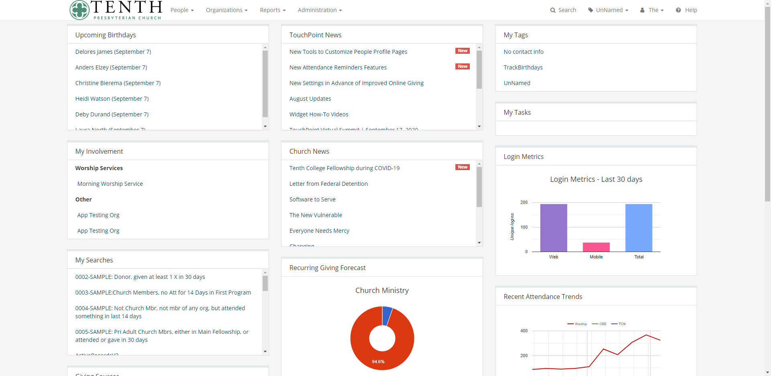
Navigation Bar

Slide 22
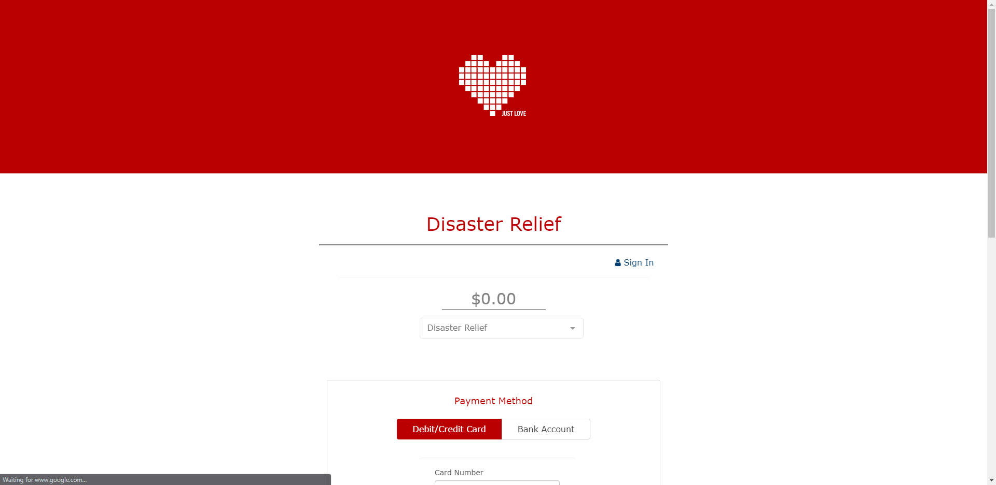
Online Giving

Slide 23
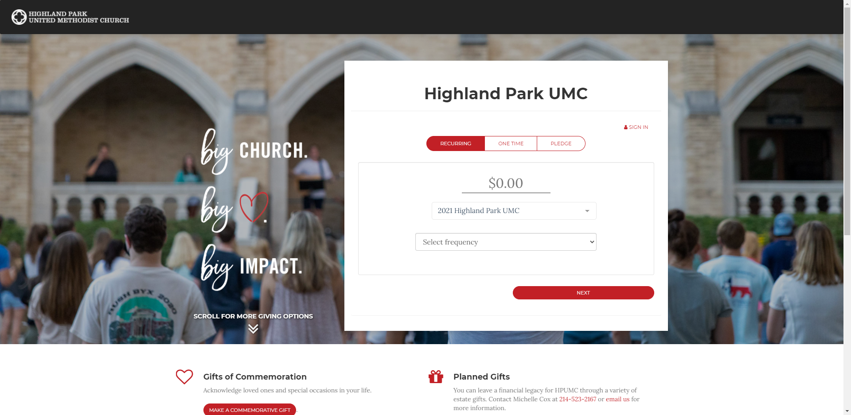
Online Giving

Slide 24
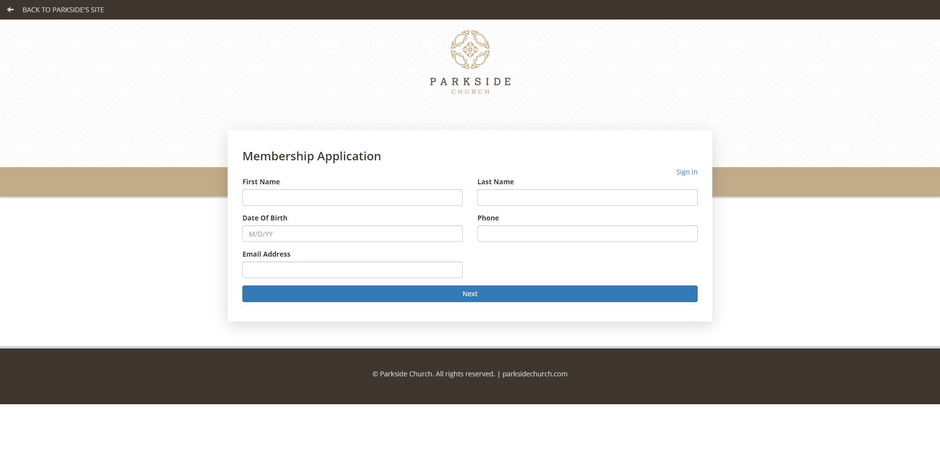
Online Registrations

Slide 25
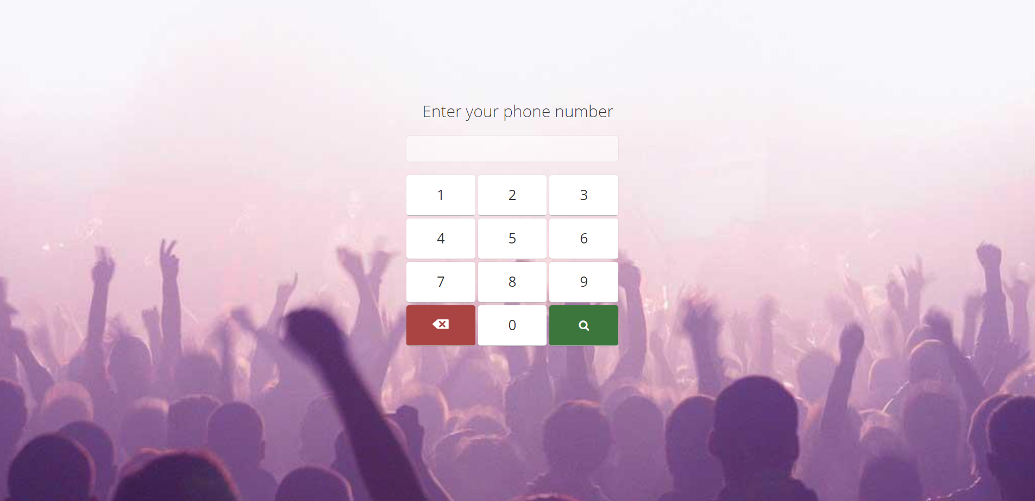
Web Check-In

Slide 26
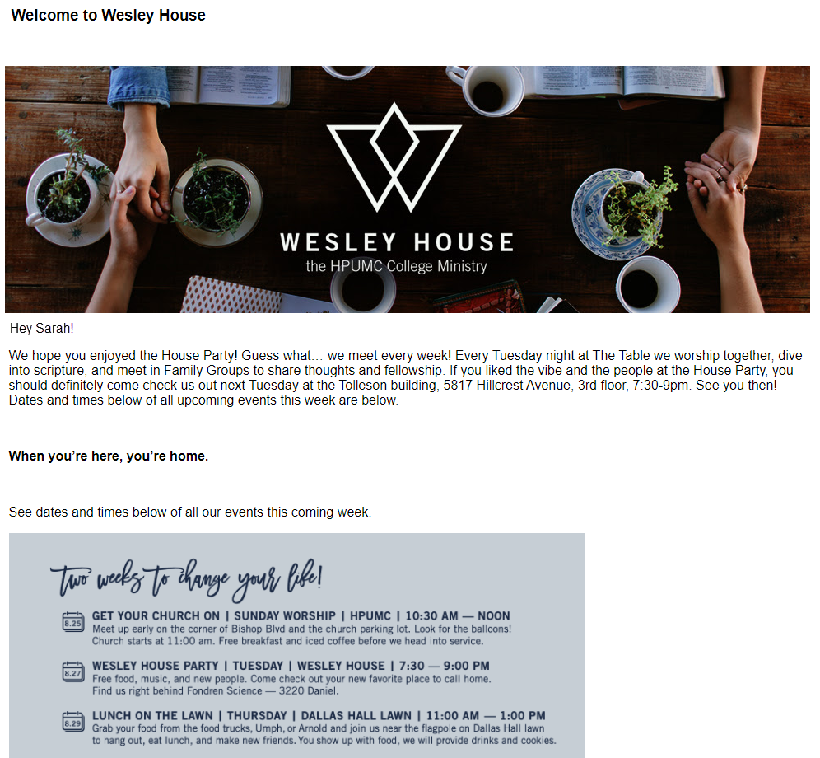
Emails
Notes:
TouchPoint allows Email Templates and System-Generated Emails to be Branded however you like.
We have an easy-to-use Mobile-Friendly Email Builder which will allow you to create beautiful, branded, mobile-friendly emails.
Many churches create and save Templates per Ministry. You may also want separate Templates per Event.
Check out our Free 30-Minute Training on the Email Builder to learn more.

Slide 27
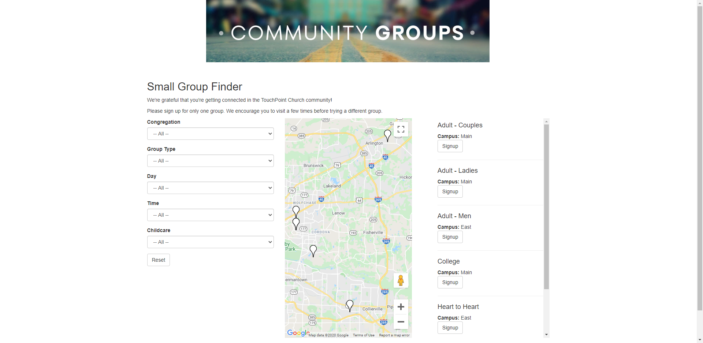
Small Group Finder
Notes:
The Small Group Finder is one of the most unique tools inside of TouchPoint. It’s what your churchgoers will use to search for and register for a group.
Many churches use the Small Group Finder to list their In-Home Groups, On-Campus Groups, Volunteer Opportunities, Mission Trips, etc.

Slide 28
Custom Domain
My.bellevue.org
MyAccount.englewood.church
Portal.whcchome.org
MyStAnn.org
BeLeavener.com
Notes:
The Custom Domain allows your churchgoers to type in a customized URL (that is owned by the church) into the address bar, and they will be redirected to your TouchPoint Database.
So for example, they may be able to visit “My.TouchPointChurch.Com” instead of “TouchPoint.TPSDB.Com.”
This feature requires development resources and is available for a one-time fee of $350.

Slide 29
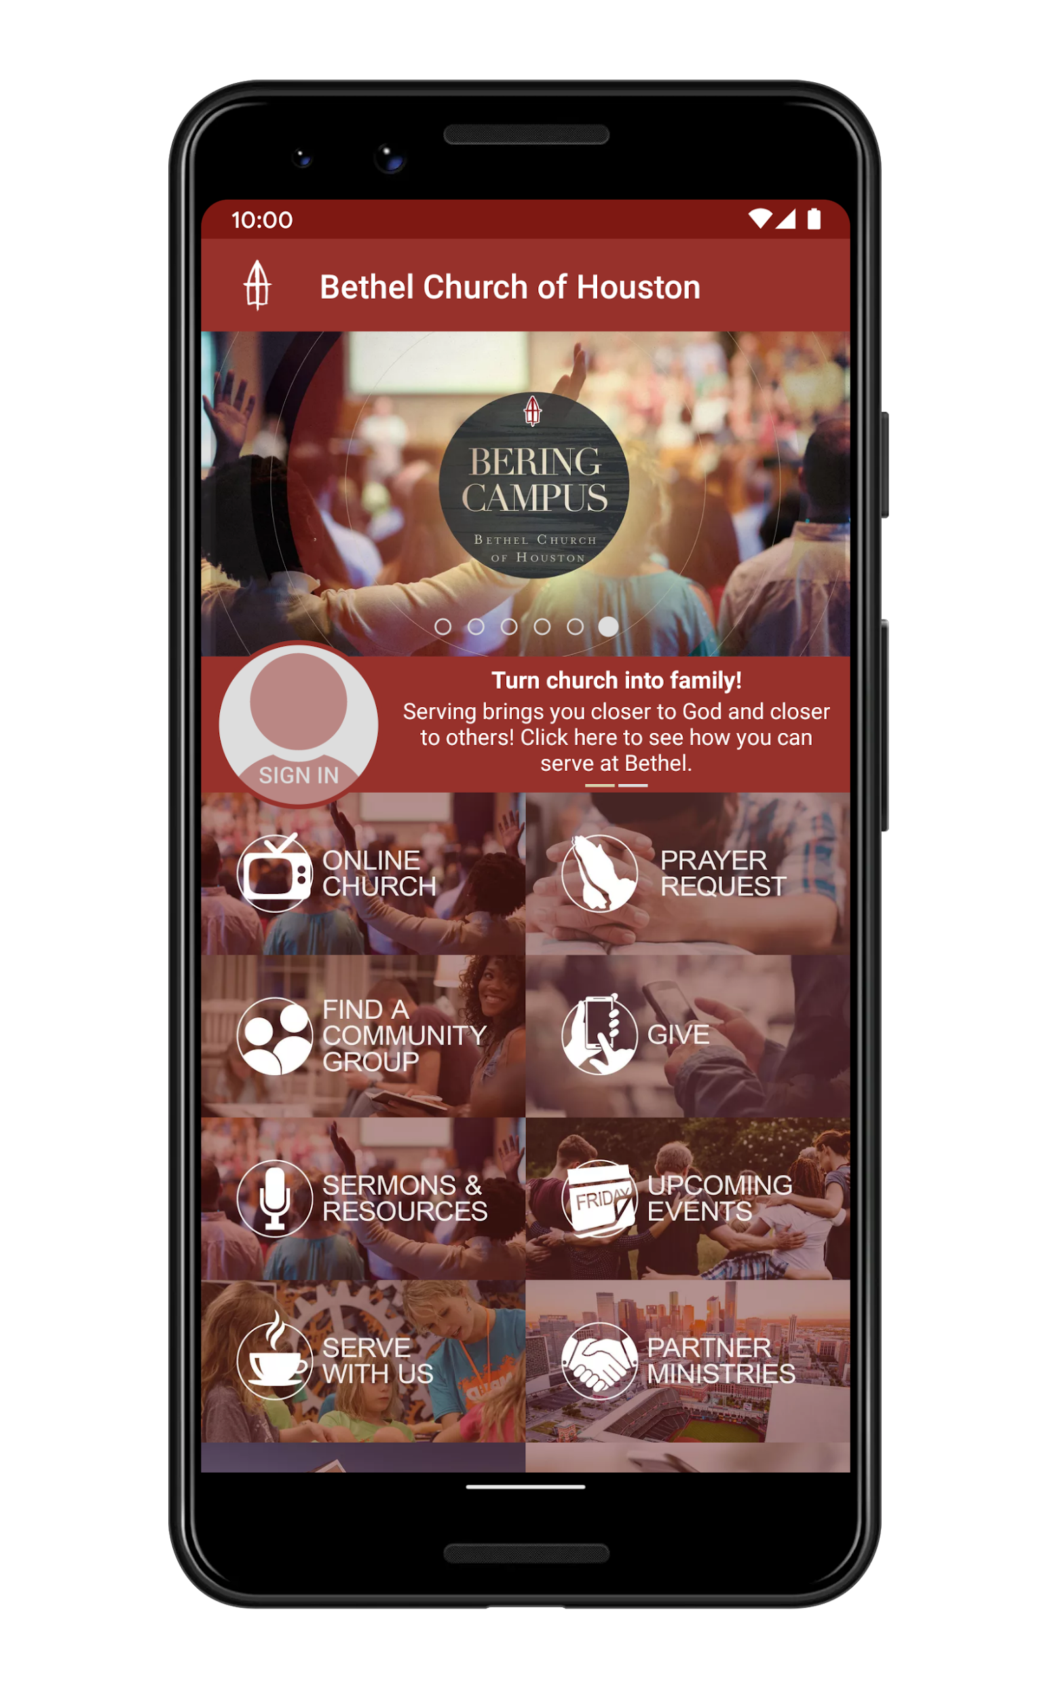
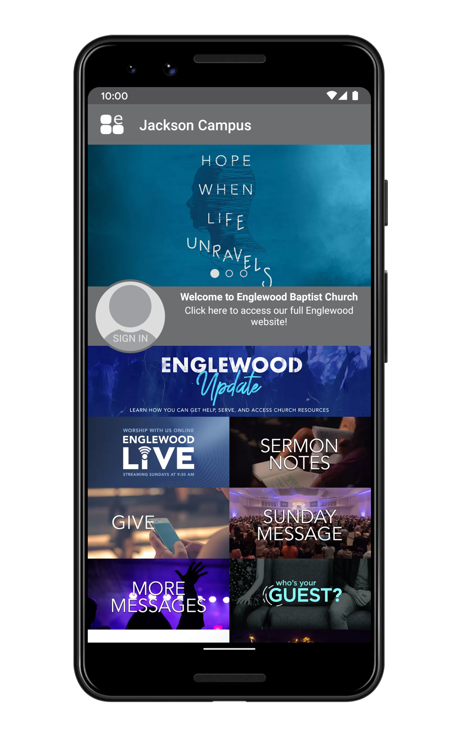

Custom-Branded Mobile App

Slide 30

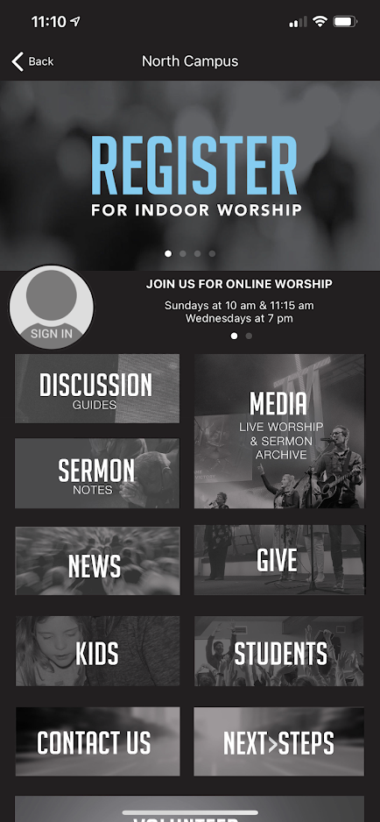
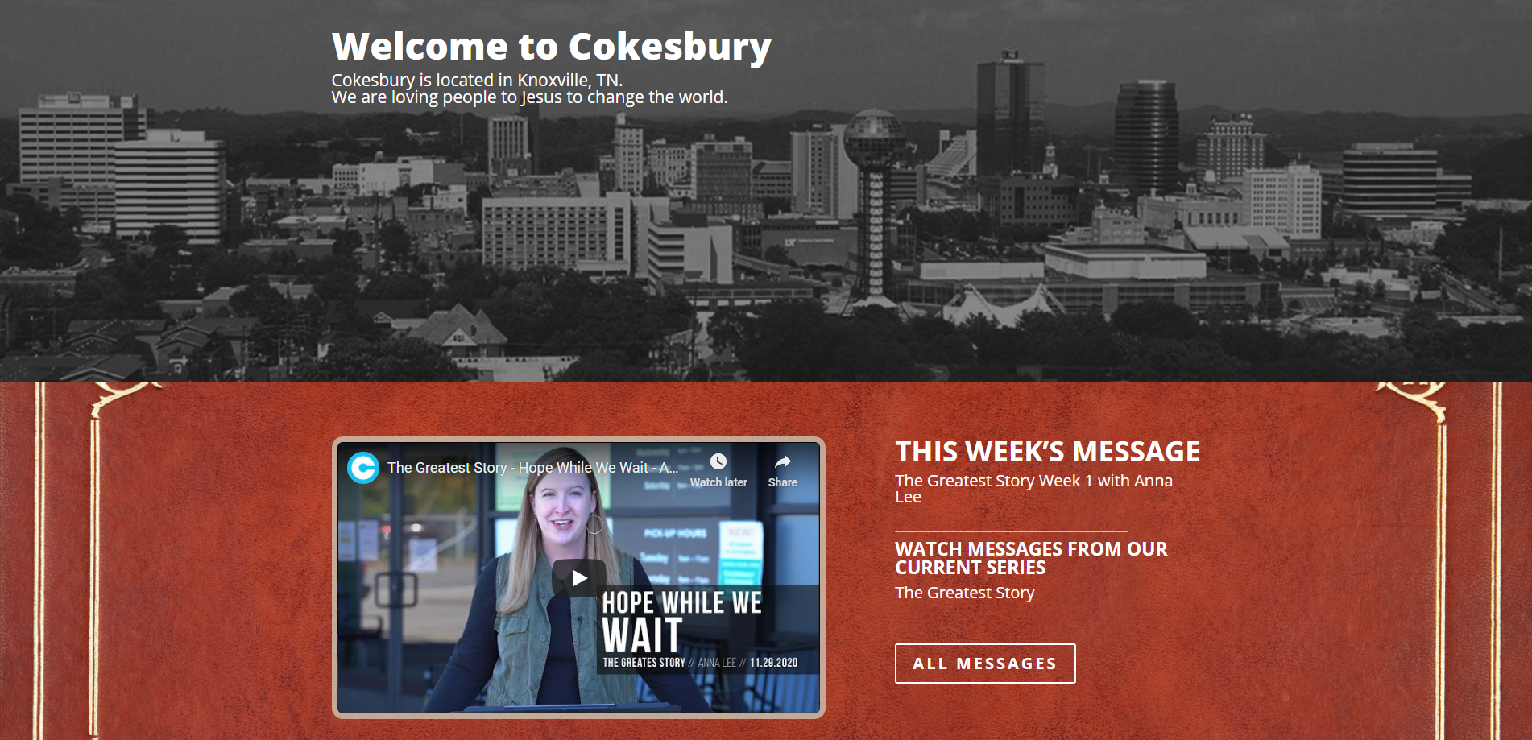
Mobile App + Website Consistency

Slide 31

Helpful Resources
TouchPoint University - Training available to TouchPoint churches
TouchPoint Help Articles
  Default Shell for Online Registrations
  Using a Custom Login Page
  Using a Custom Header
  Web Check-In Design
  Small Group Finder
Unsplash.com - Freely-usable images
Color Picker - Find the exact HTML color code
Coolors.co - Color scheme generator
Bootstrap Docs - TouchPoint CSS framework
Codecademy - Learn to code

Slide 32


touchpointsoftware.com • 1-888-788-6348

