Slide 1
What’s the Point…
of Event Ticketing?
Thursday, July 29 - 2pm Central
Making Ministry Easy With TouchPoint’s Solutions

Slide 2
Presenters
Andrew Triplett Director of Consulting | Michael Faulkner Vice President, Solutions

Slide 3
Housekeeping
Submit Questions using Q&A Button in Control Panel

Slide 4
Agenda
What’s the point of event ticketing?
How can ticketing help ministry?
Maximize Guest Experience
Ticket Management
TouchPoint’s Event Ticketing Solution

Slide 5
What’s the Point of Event Ticketing?

Slide 6
Event Ticketing:
First, ask why the event is happening?
Then ask how ticketing can help address the “why” around the event.

Slide 7
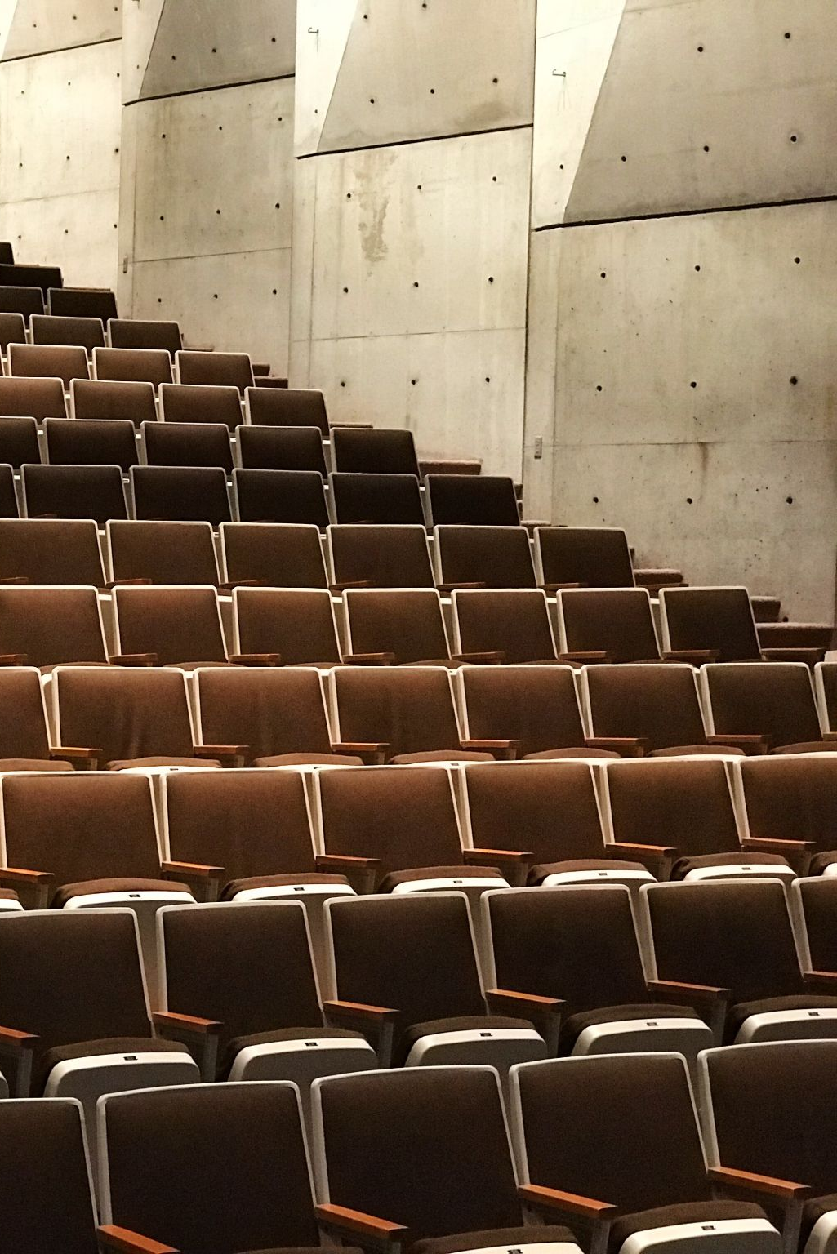
Why Use Event Ticketing?
Creates ministerial opportunities
Creates a calm, relaxed environment
Eliminates possible conflict between attendees
Maintains special circumstance accommodations (like social distancing)
Sets staff up for success

Slide 8
How Can Ticketing Help Ministry?

Slide 9
Maximize Ministry Efforts
Minimize frustrations; maximize enjoyment
Prepares audience for receiving the message/experiencing entertainment
Enables outreach to the unchurched

Slide 10
Guest Experience

Slide 11
Give Your Guests The Best Experience Possible!
Digital Tickets
Scanned at Entry
Chosen Seat Assignments
Stress-Free Experience!

Slide 12
Ticketing Management

Slide 13
Planning Made Easy
The Christmas season is filled with church-hosted events.
Create multiple venues per campus!

Slide 14
Set Staff Up for Success
Easy Scanning
Virtual Box Office
Accessible Floor Map

Slide 15
TouchPoint’s Ticketing Solution

Slide 16
Various Ticketing Options
General Admission
Seated Admission
General Admission by Section
Paid
Free
Discount Codes
Matinee vs Evening Pricing

Slide 17
Ticketing from Right Inside of TouchPoint
TouchPoint offers a fully immersive ticketing solution.
Our ticketing solution helps you know who is participating in your events, which leads to a seamless ministerial experience.

Slide 18
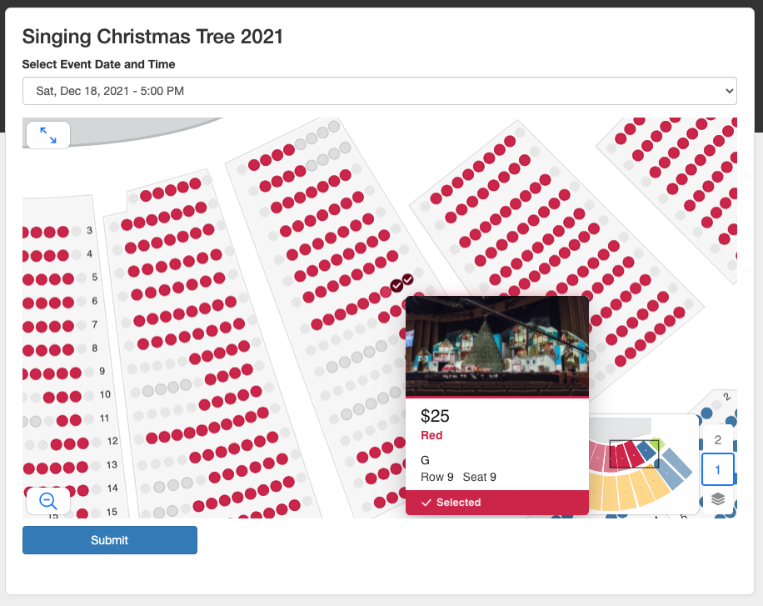
Venue Availability

Slide 19
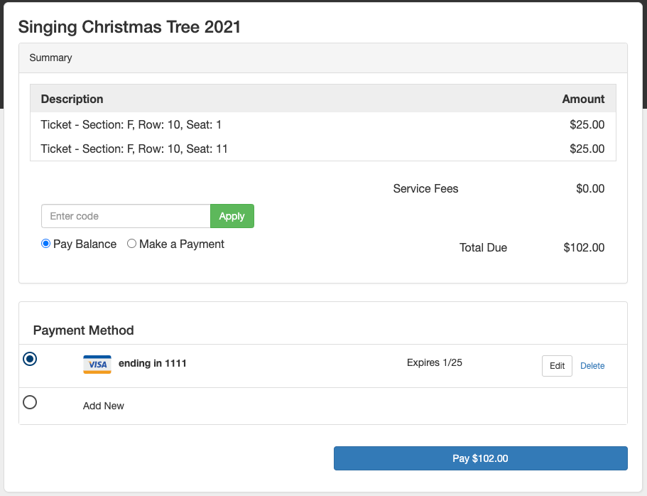
Venue Availability

Slide 20
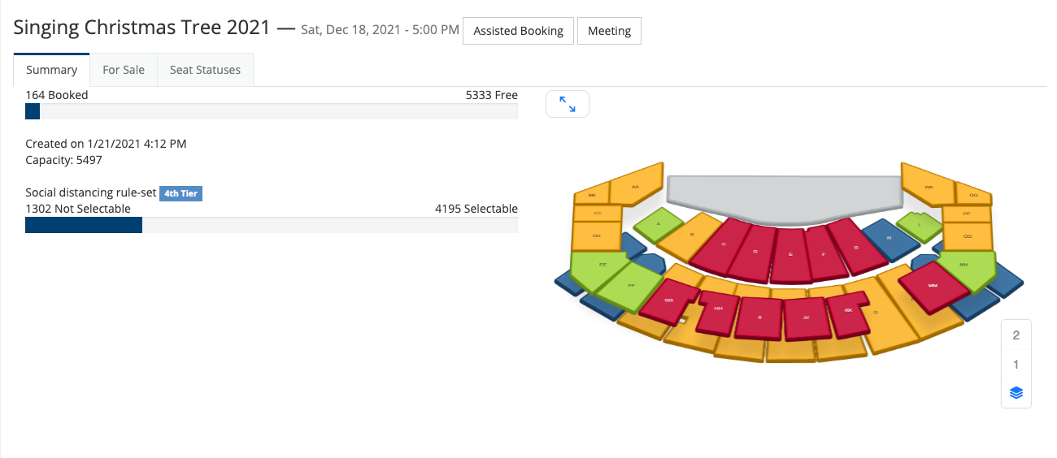
Event Management

Slide 21
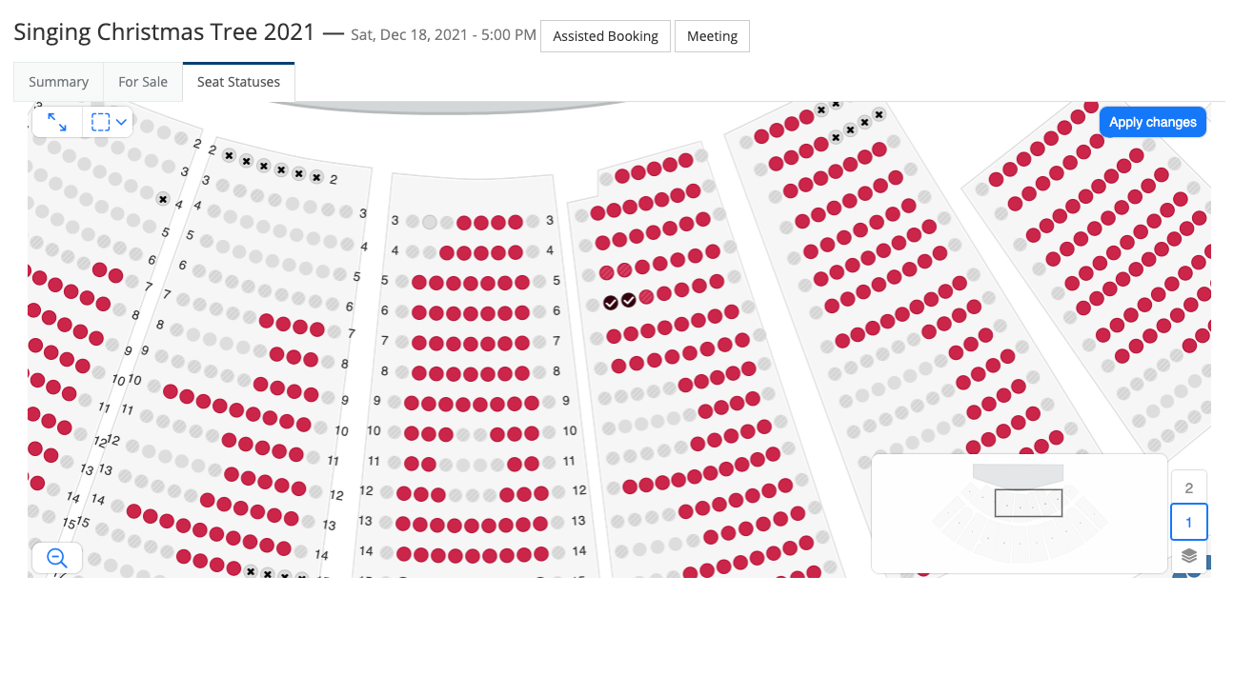
Event Management

Slide 22
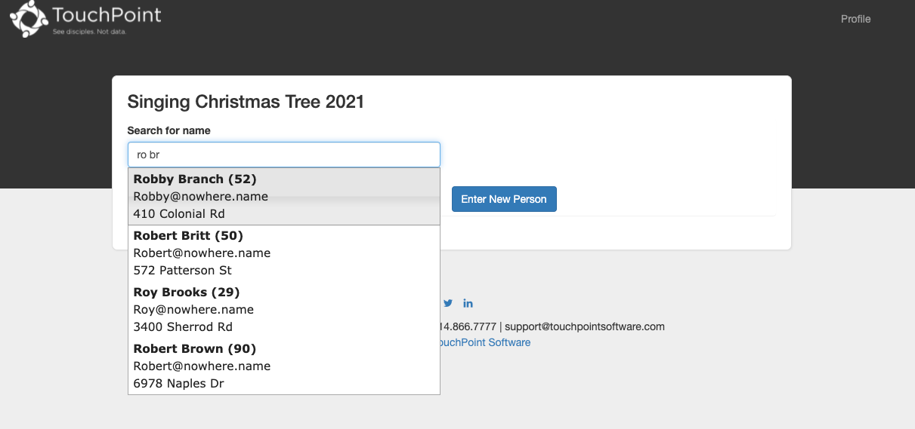
Event Management

Slide 23
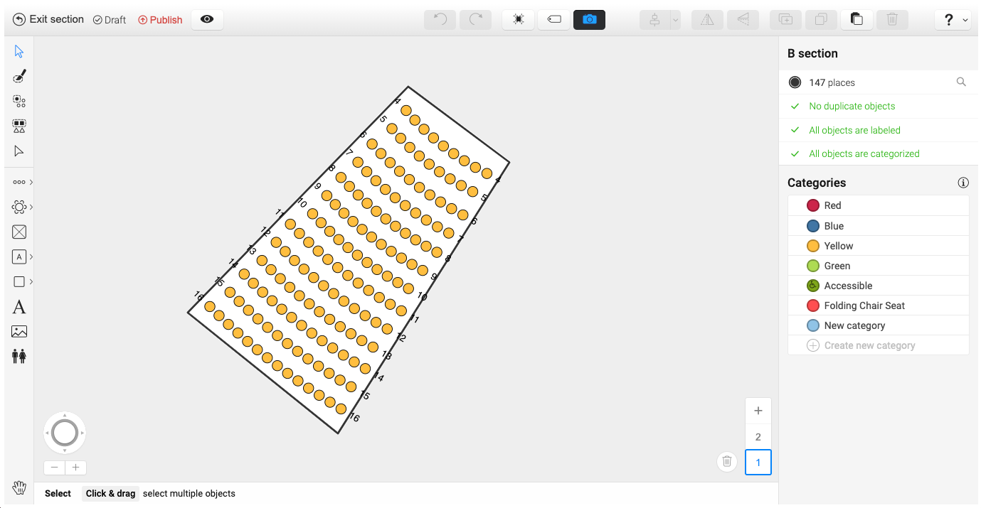
Customize Your Space

Slide 24
Custom Ticket Example

Slide 25
Custom Ticket Example

Slide 26
touchpointsoftware.com • 1-888-788-6348

