Slide 1


What’s the Point…
of Breaking Down The Walls?
Community Outreach In A Digital World
August 25th - 2pm Central
Making Ministry Easy With TouchPoint’s Solutions

Slide 2




Presenters
Michael Faulkner Solutions | Erik Smith Solutions

Slide 3
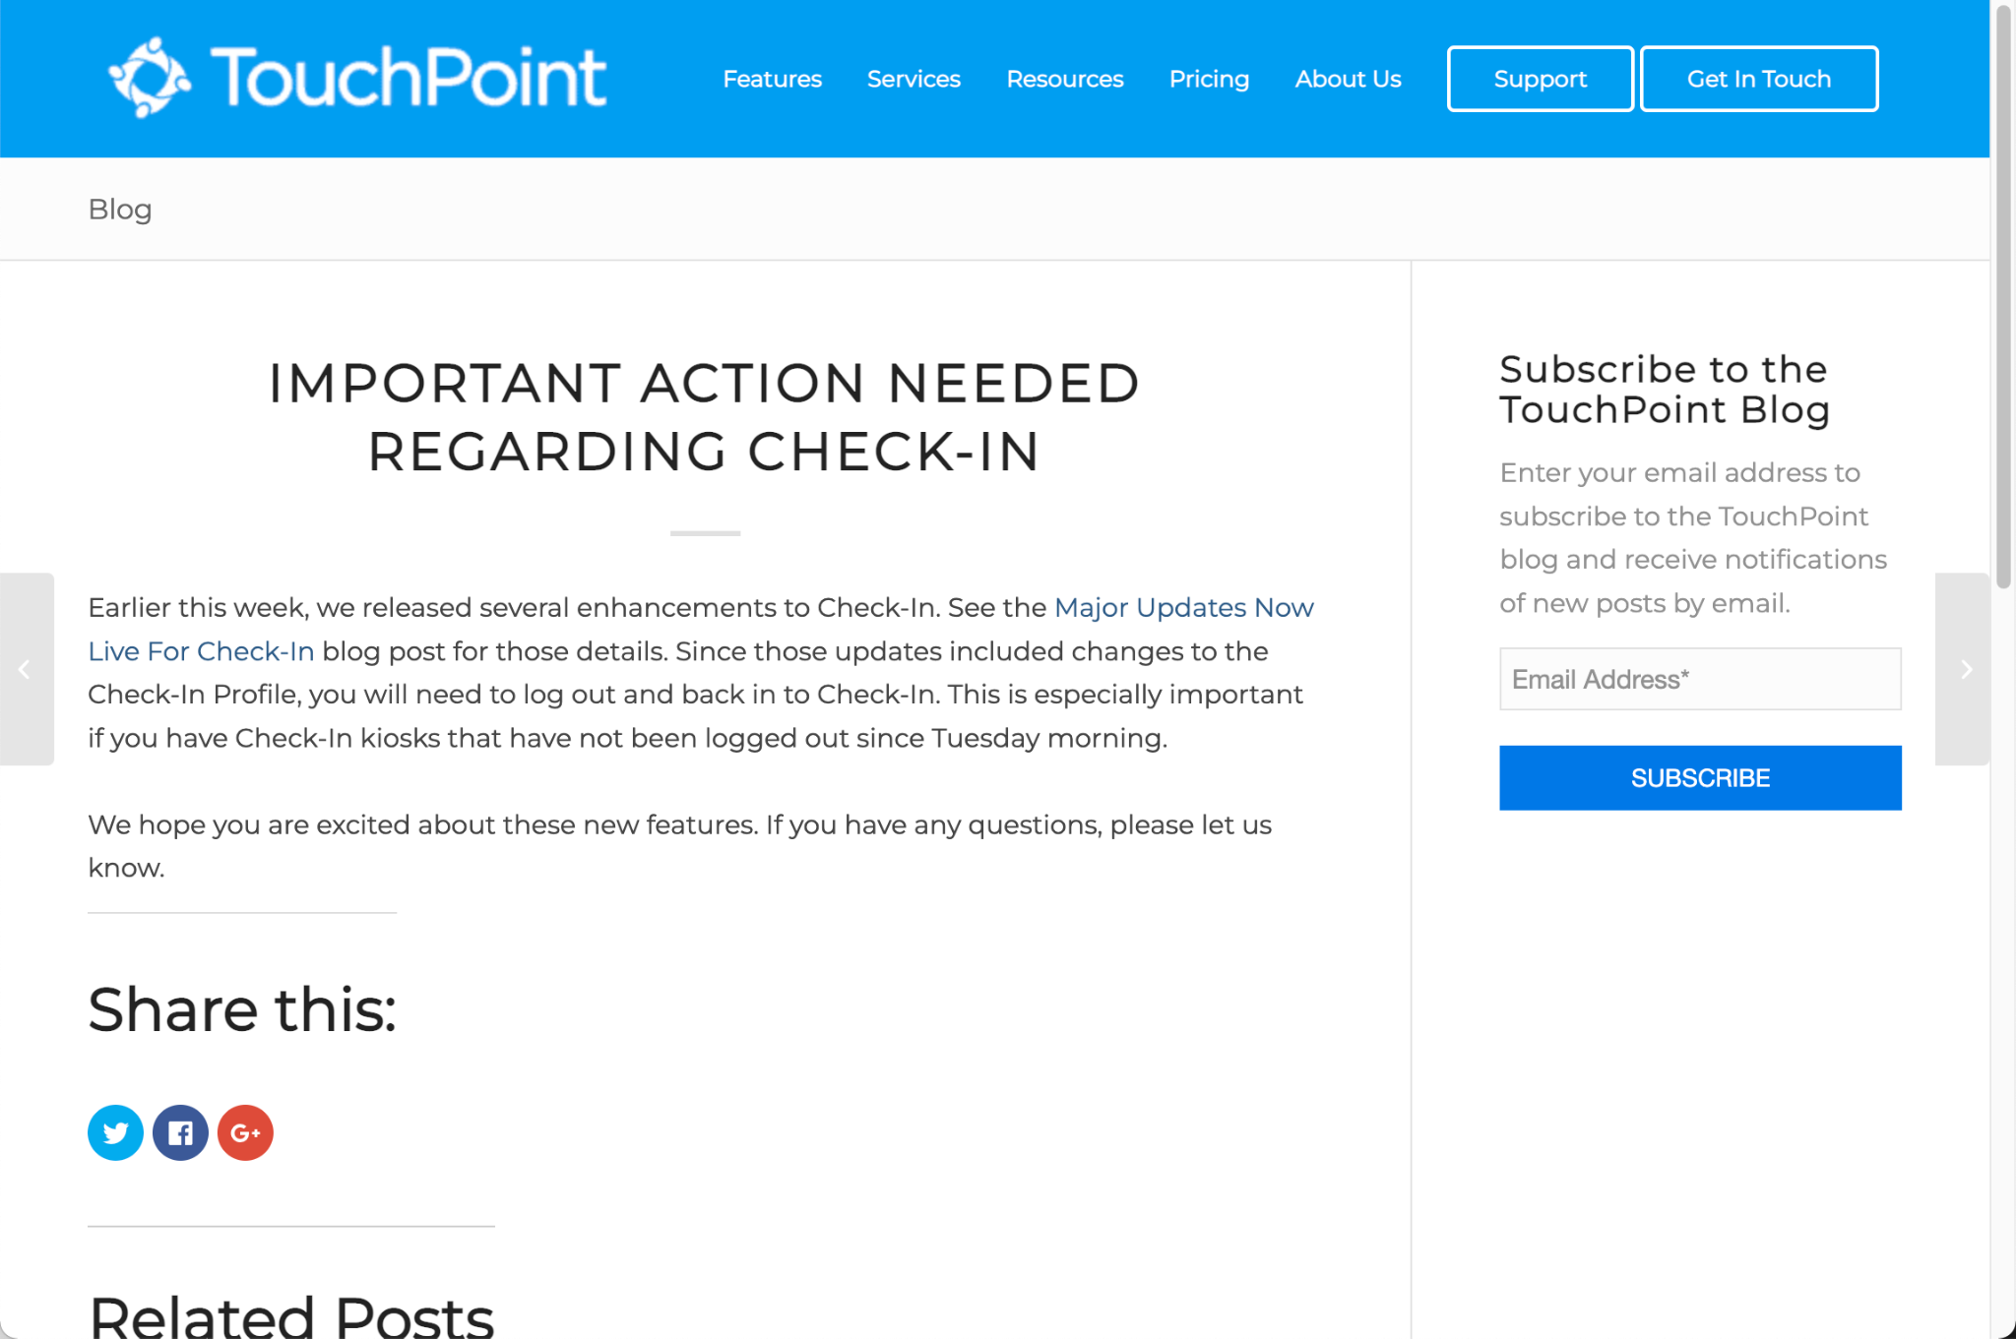
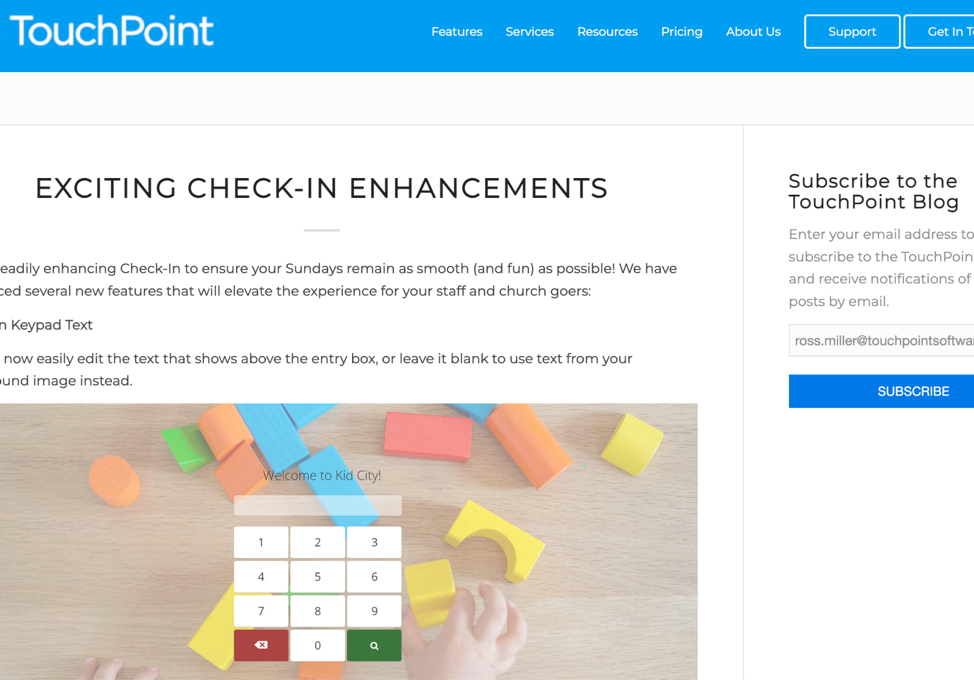
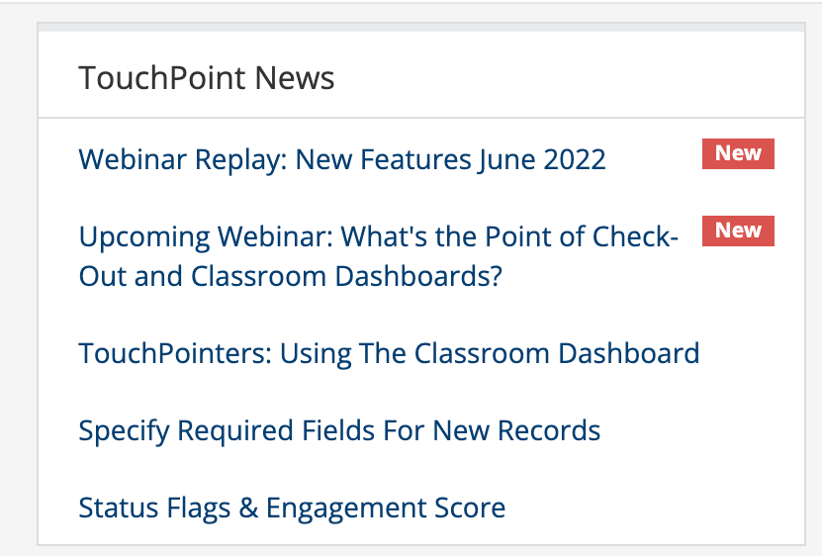
Subscribe!
https://www.touchpointsoftware.com/subscribetoblog

Slide 4

Agenda
The Importance of Community Outreach
  Reaching the Unchurched
  Deepening Relationships With Christ
Methods of Outreach
  Community Events & Registrations
  Group Finder
  Mission Trips
  Communication
  Volunteer Opportunities
Managing the Outreach
  Scheduler
  Tasks & Notes
  Attendance
  Searches & Reports
  Widgets & Dashboards
TouchPoint Software

Slide 5
What’s the Point?

Slide 6

Community Outreach

Slide 7

Community &
Church Benefits

Slide 8

Methods
Of Digital
Community
Outreach

Slide 9

Community Events
Open Your Doors To Your Community
New Faces + Familiar Faces

Slide 10

Holidays &
Special Events
Christmas Pageant
4th of July Celebration
Thanksgiving Potluck
Super Bowl Party
Trunk or Treat
Easter Egg Hunt

Slide 11

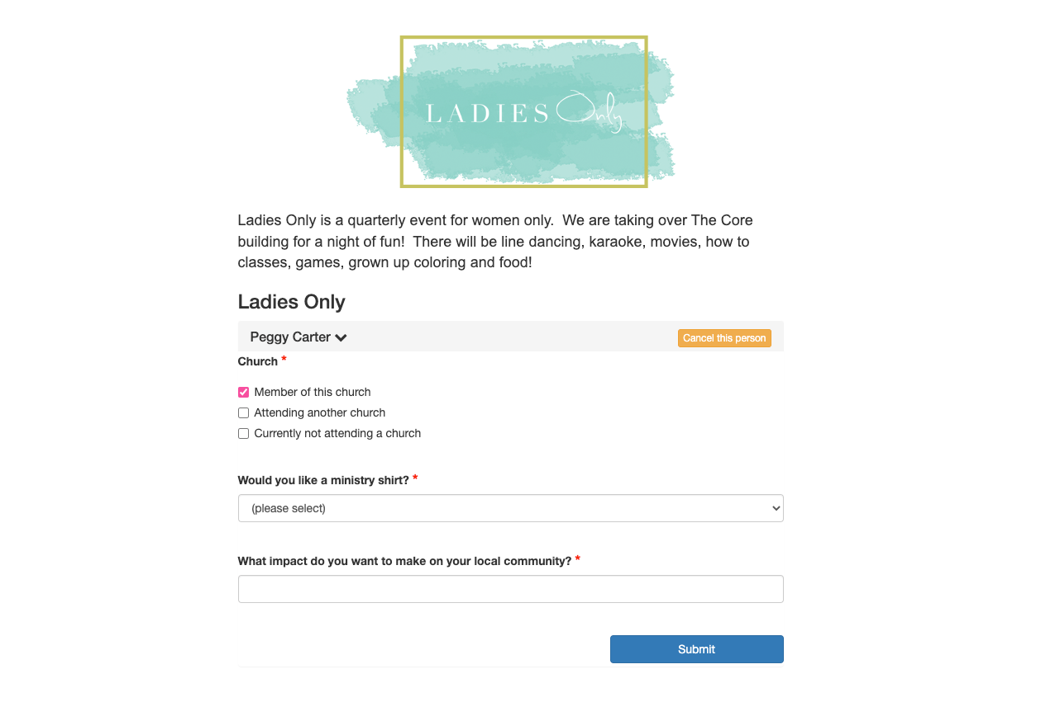
Online Registration
Vacation Bible School
Sports League
Date Night with Free Childcare
Prenatal Classes
Recovery Services
Christian Concert
Community-Wide Yard Sale

Slide 12

Group Finder
Community Group
Volunteer Sign-Up
Mission Trips
Sunday School
Bible Study Group

Slide 13
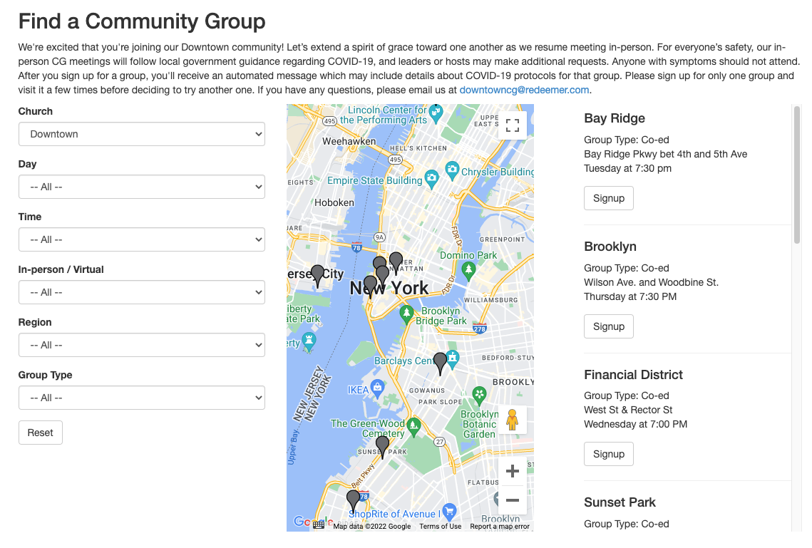
Group Finder

Slide 14
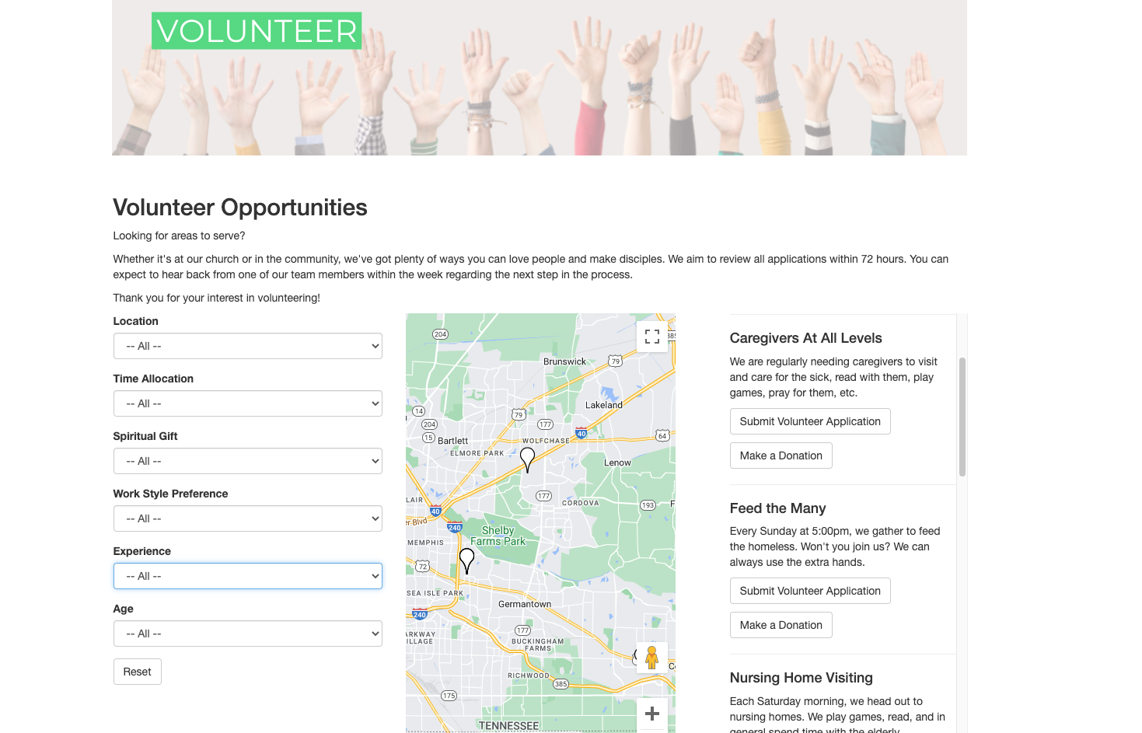
Special Group Finders

Slide 15

Missions

Slide 16

Local Mission Trips
Homeless Shelter
Baseball Camp
Road to Recovery
COS I Love You

Slide 17
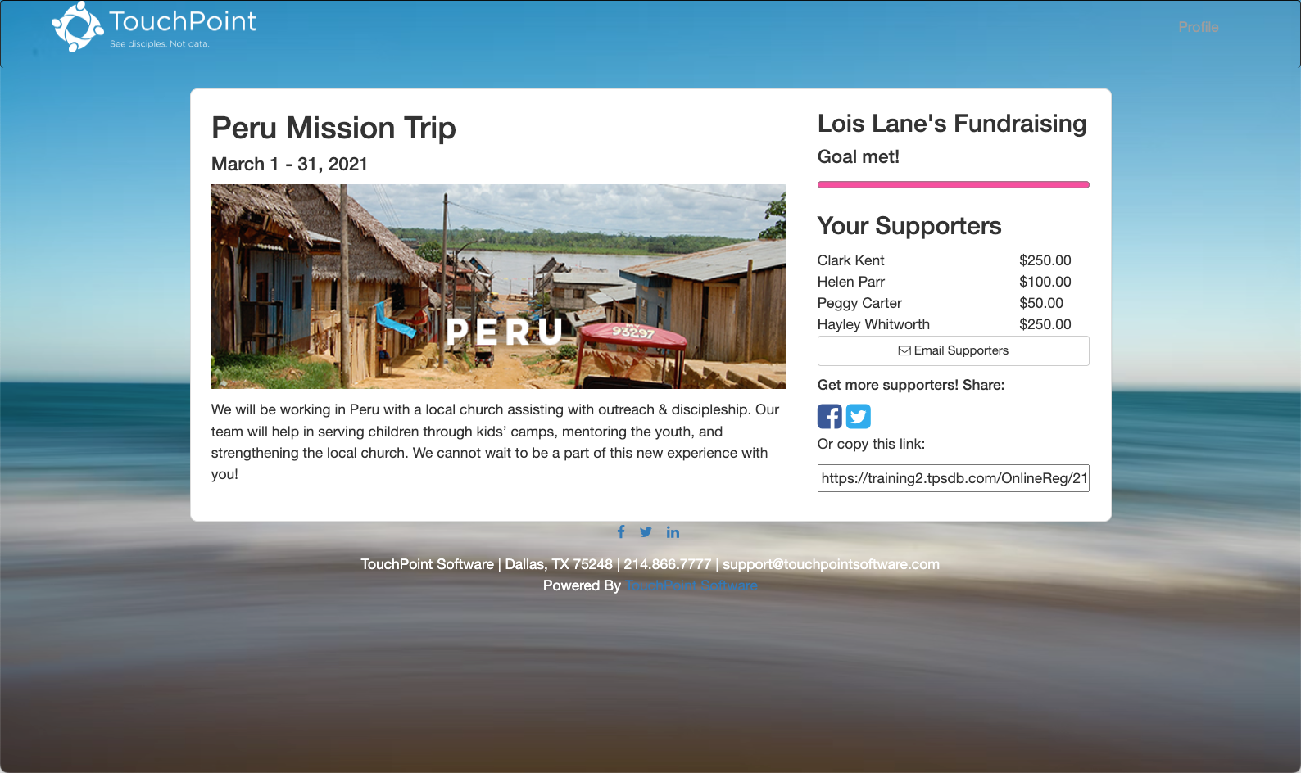
Mission Trips

Slide 18
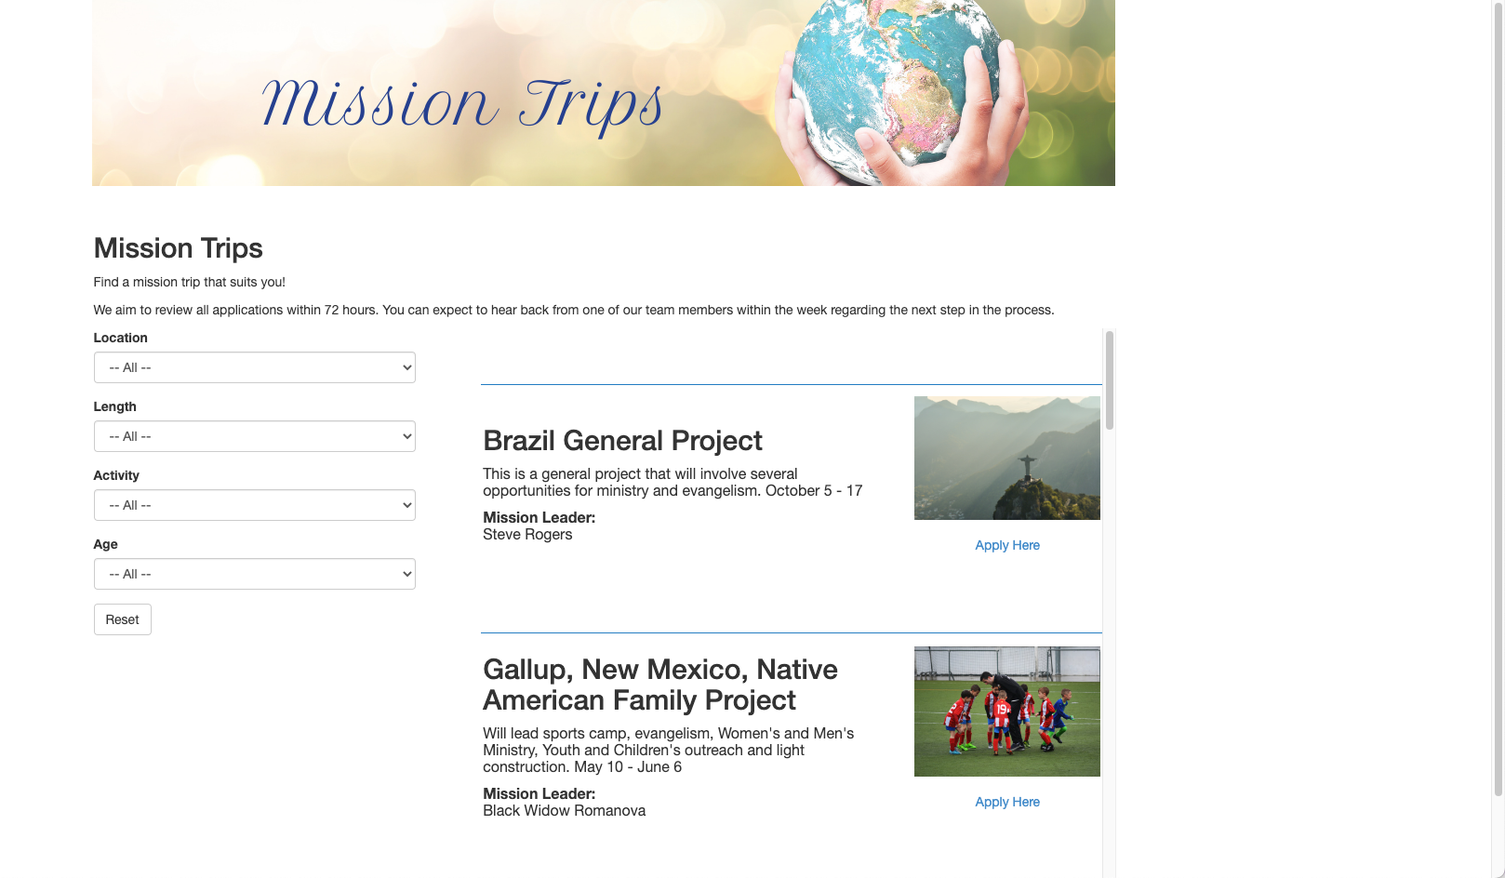
Mission Trips

Slide 19

Church Communication

Slide 20


Emails

Slide 21
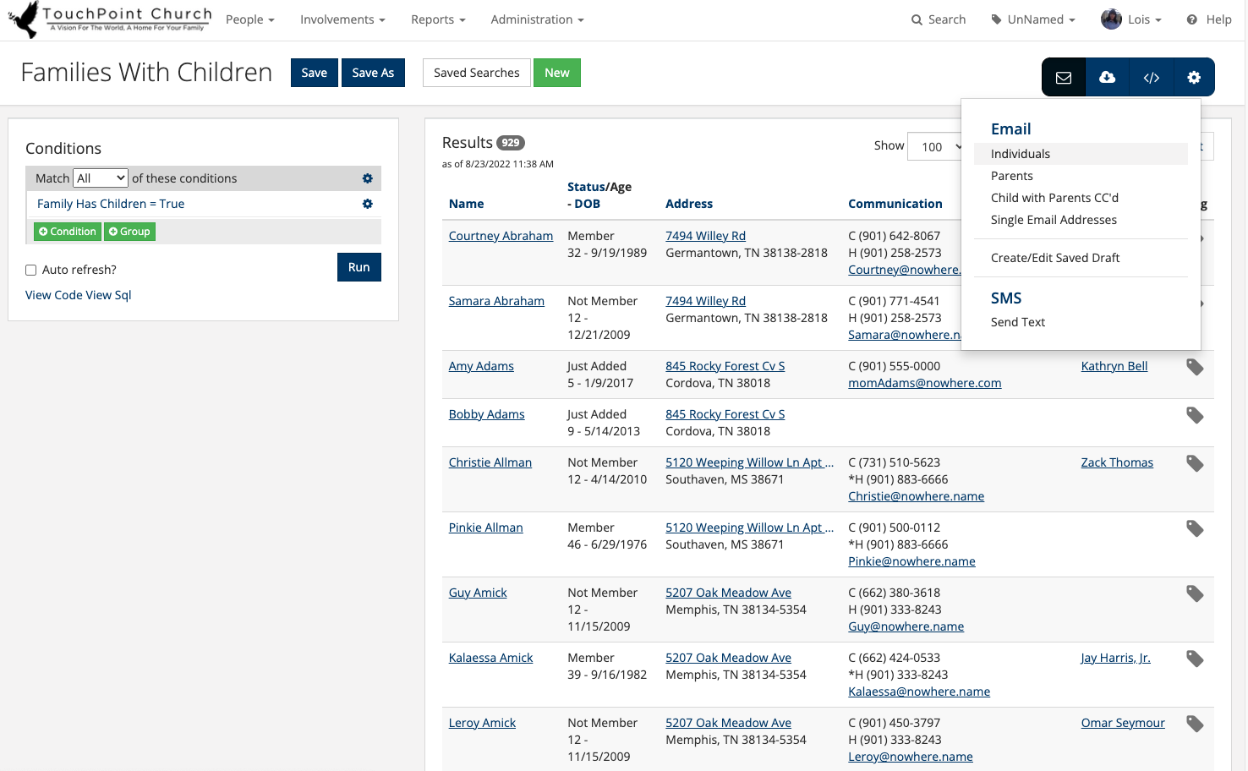
Emails

Slide 22

Texting
Serving Commitments
Events
Recording Attendance
Reply Words

Slide 23

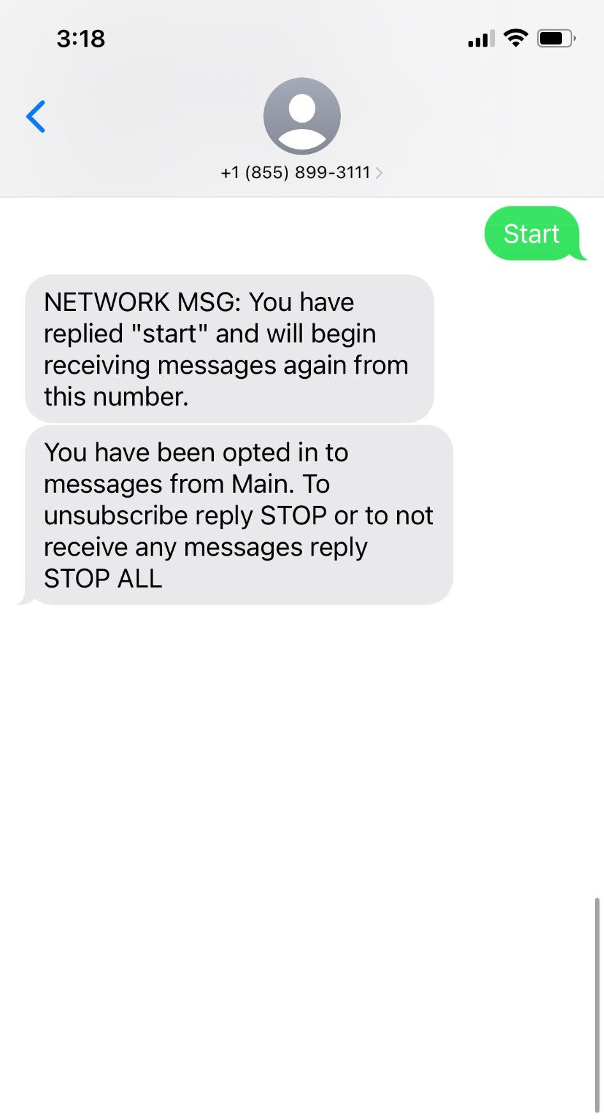
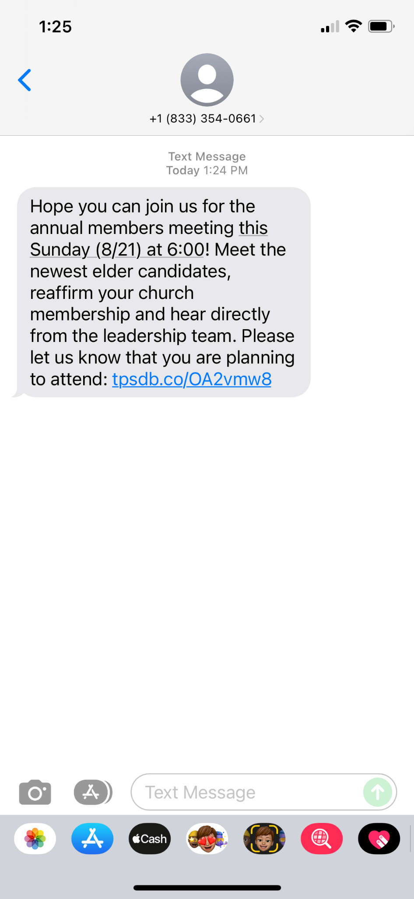
Texting

Slide 24

Volunteer Opportunities

Slide 25
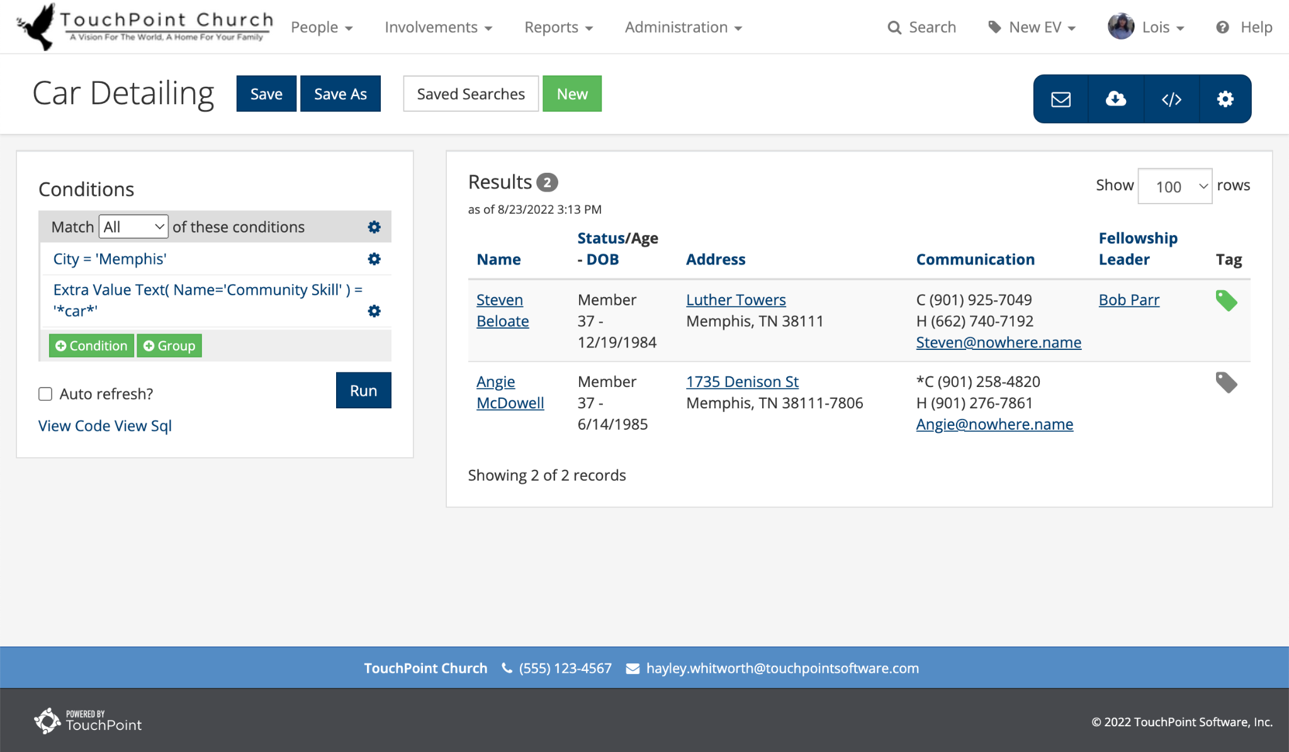
Volunteer Skills Extra Value

Slide 26

Managing the Outreach
In a Digital World

Slide 27
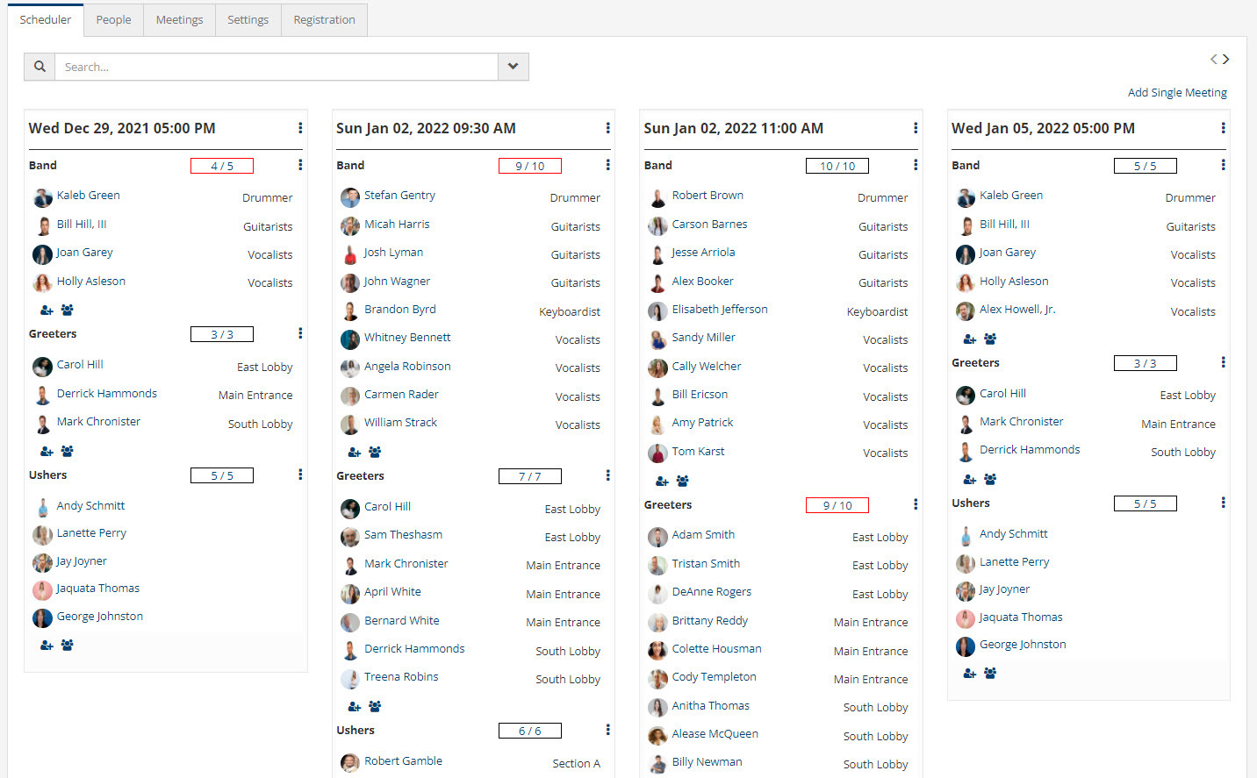
Scheduler

Slide 28
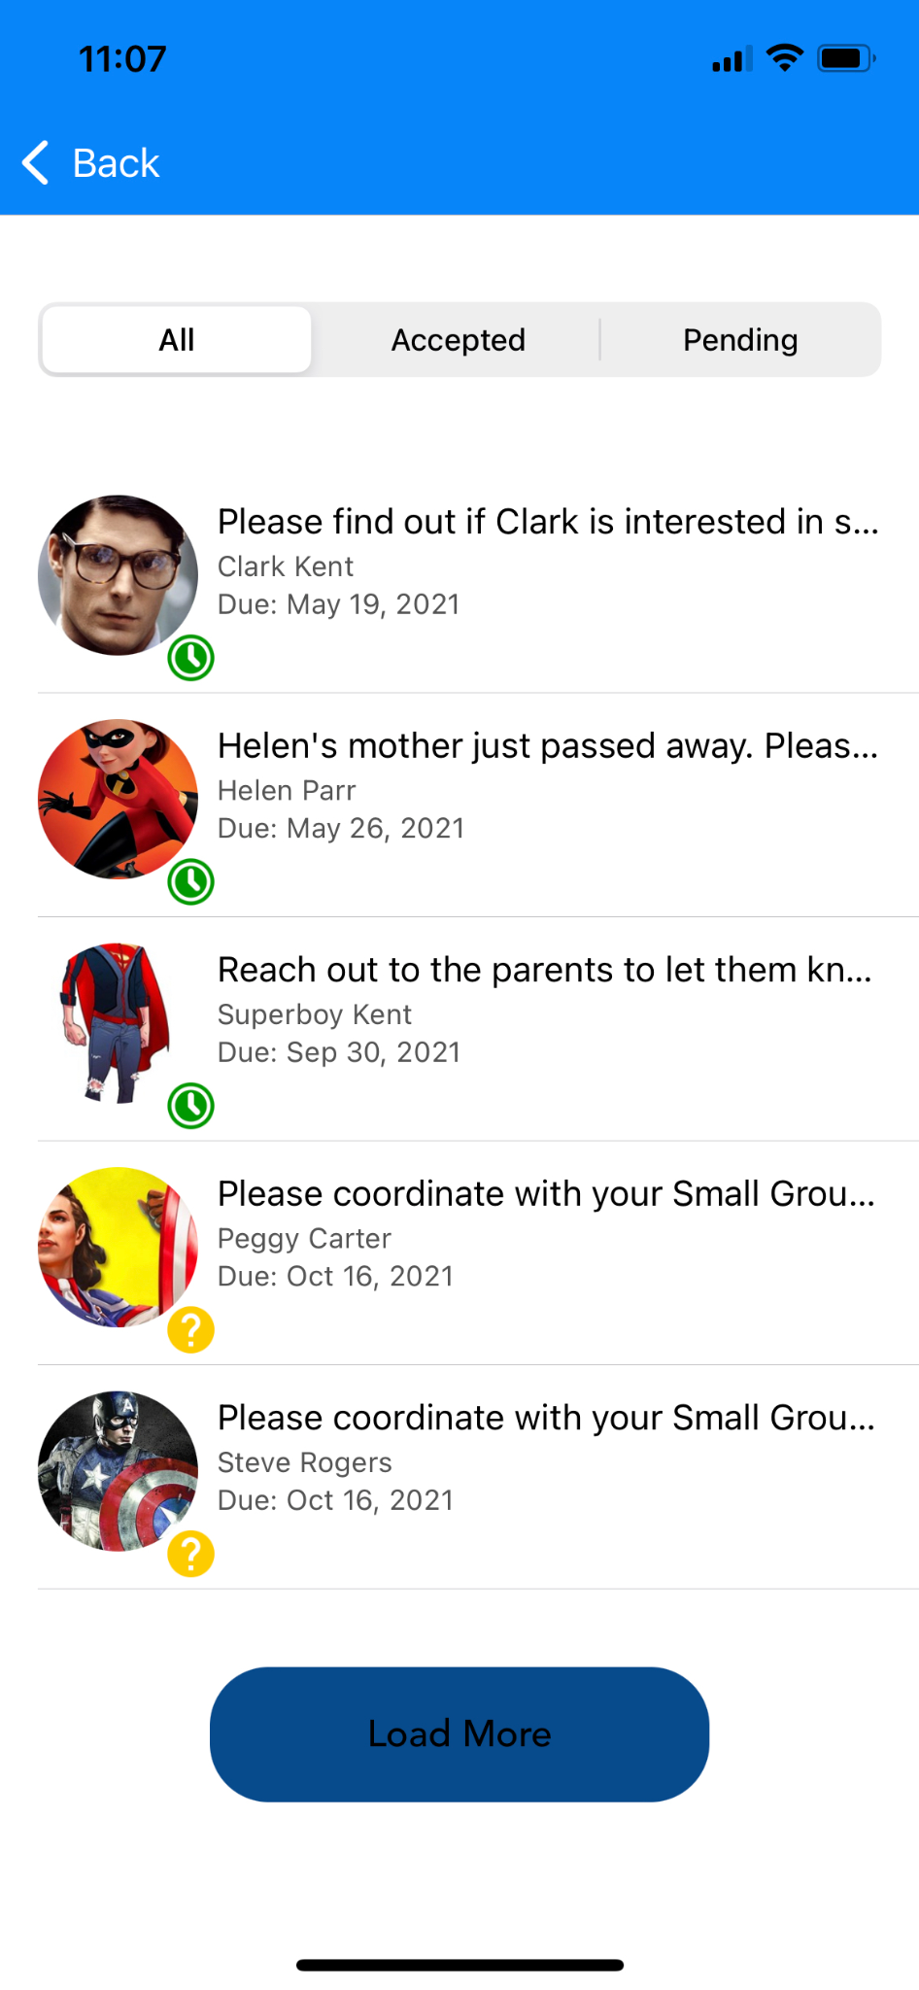
Tasks & Notes

Slide 29
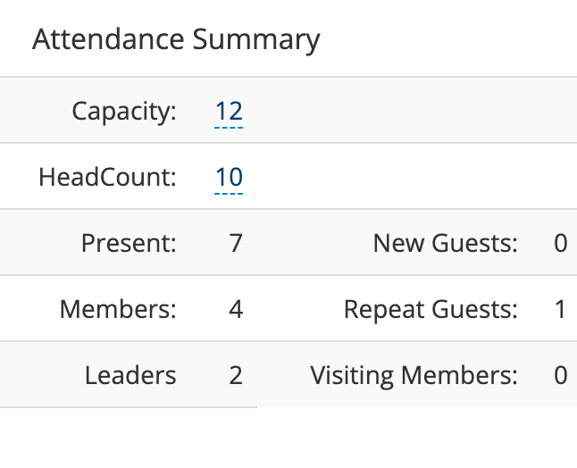

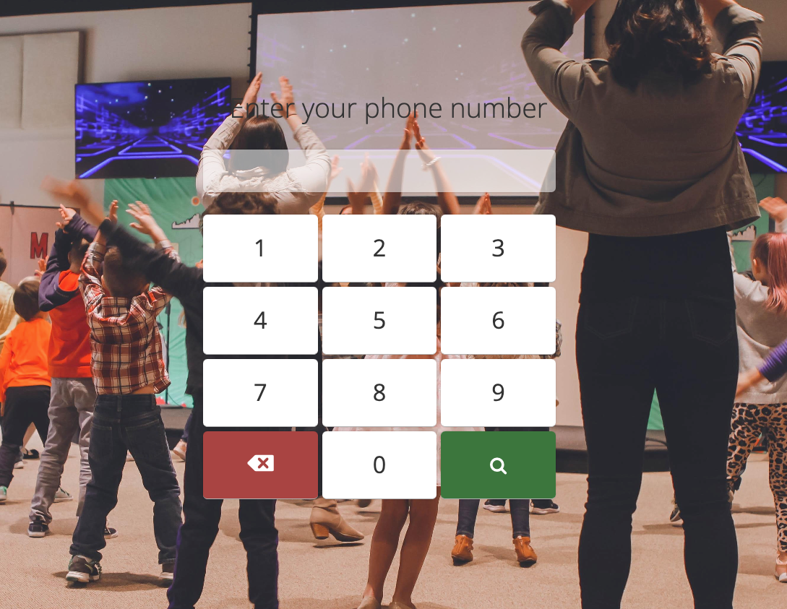
Attendance

Slide 30

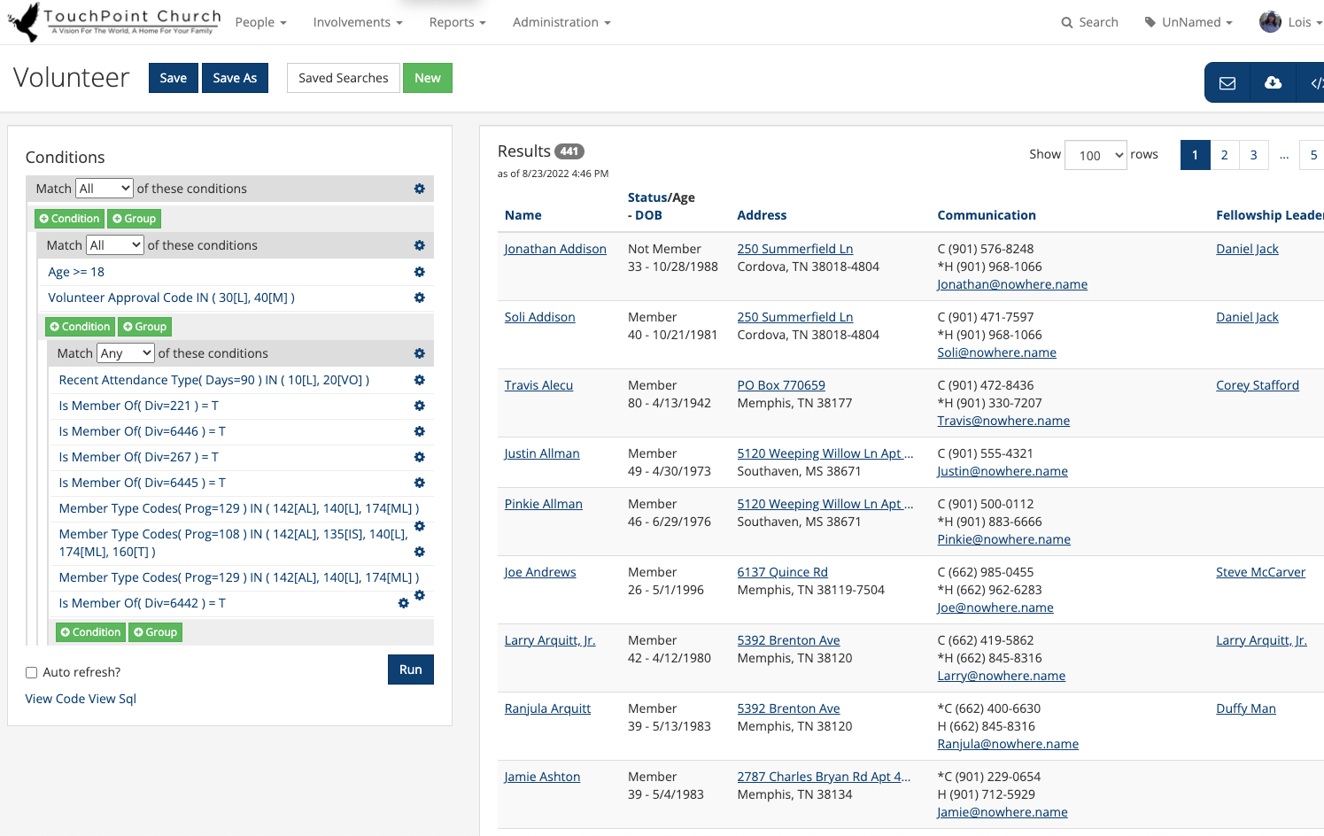
Searches & Reports

Slide 31
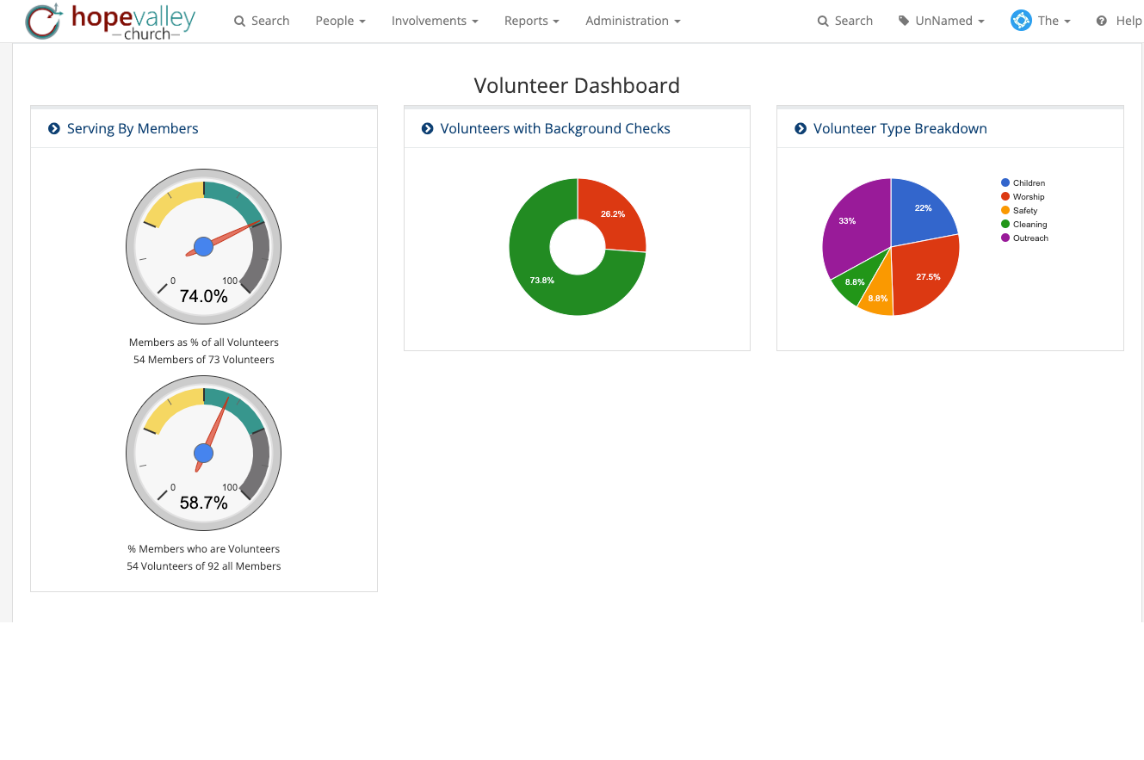
Dashboard Widgets

Slide 32


Slide 33

Submit Your Questions

Slide 34
Thank You!
Get In Touch!
TouchPointSoftware.com
Solutions@TouchPointSoftware.com

