Slide 1
What’s the Point…
of TouchPoint Giving?
Thursday, October 27th - 2pm Central
Making Ministry Easy With TouchPoint’s Solutions

Slide 2
Presenters
Michael Faulkner Solutions | Erik Smith Giving Solutions

Slide 3
Agenda
Generosity Insights
Ministry Needs
Peek Into Giving

Slide 4
Generosity Insight

Slide 6
A Current View
Your Givers
Notes:
Erik

Slide 7
A More Accurate View
Your Potential Givers
Notes:
Erik

Slide 8
Range Of Estimates On Non-Givers
55-80%

Slide 9
Addressing Your Non-Givers
The smallest percentage give the largest amount (80/20 rule)
Stewardship does not start with radical generosity
Generosity is a Journey
People desire to be generous, BUT…
​Donors want to give through the church
It all starts with Trust & Relationship

Slide 10
PASTOR IT
The Currency Of Relationships Is Trust And Communication
First time Giver Contact
Small groups (Correlation)
Special gift contact
Lapse giving contact
Radical team to pastor those with the gift of giving

Slide 11
Getting Over The Hump
First Time Giving | Second Time Giving
13% chance of becoming a consistent giver | 66% chance of becoming a consistent giver
One-time can become recurring

Slide 12
Ministerial Needs

Slide 13
Fees
Avoid:
High Processing Cost
Extra Fees
Buy/Use Additional Software

Slide 14
Tools
Tracking Donor Analysis
Pastoral Care Dashboards
Fully Integrated

Slide 15
Simplicity
No Third Party
One Support Team
Simplified Contract
Cleaner Data

Slide 16
The TouchPoint Solution

Slide 17
What to Expect
Simplified Fees
Robust Reporting and Tools
Streamlined and Integrated Process
Card Updater

Slide 18
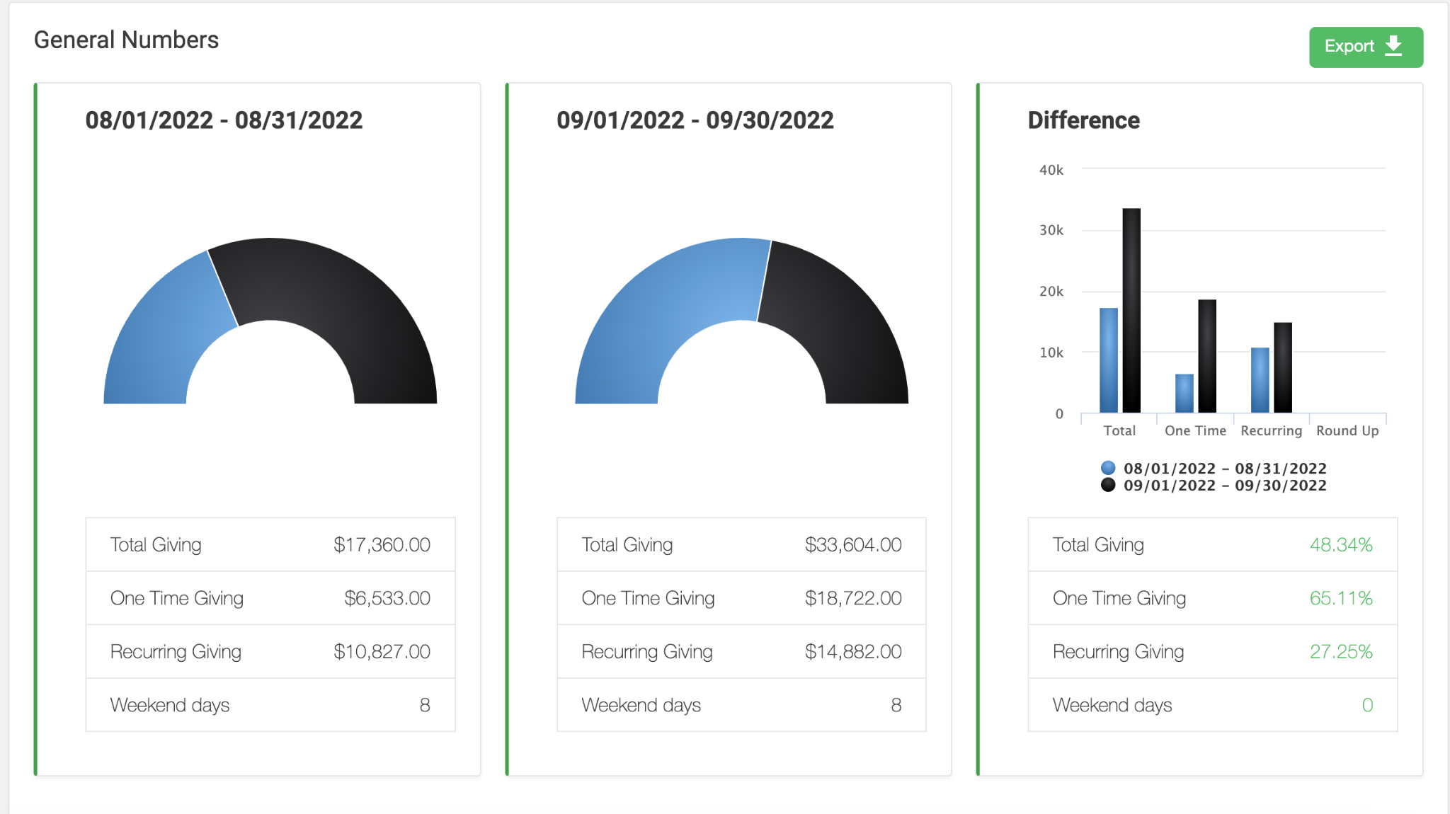
Coming Soon: Generosity Dashboards
Customizable
Real Time Updates
Pastors Can Take Immediate Action
Exclusive
*Mockup Displayed is Subject to Change
Notes:
EXCLUSIVE TO TOUCHPOINT GIVING

Slide 19
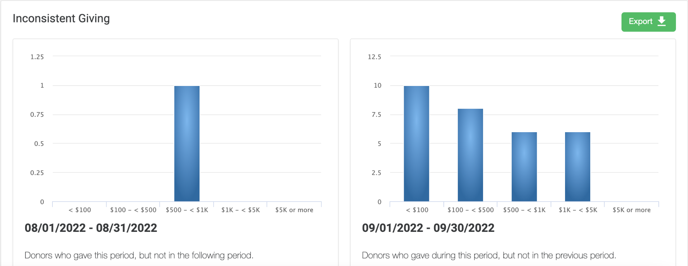
View Trends
*Mockup Displayed is Subject to Change

Slide 20
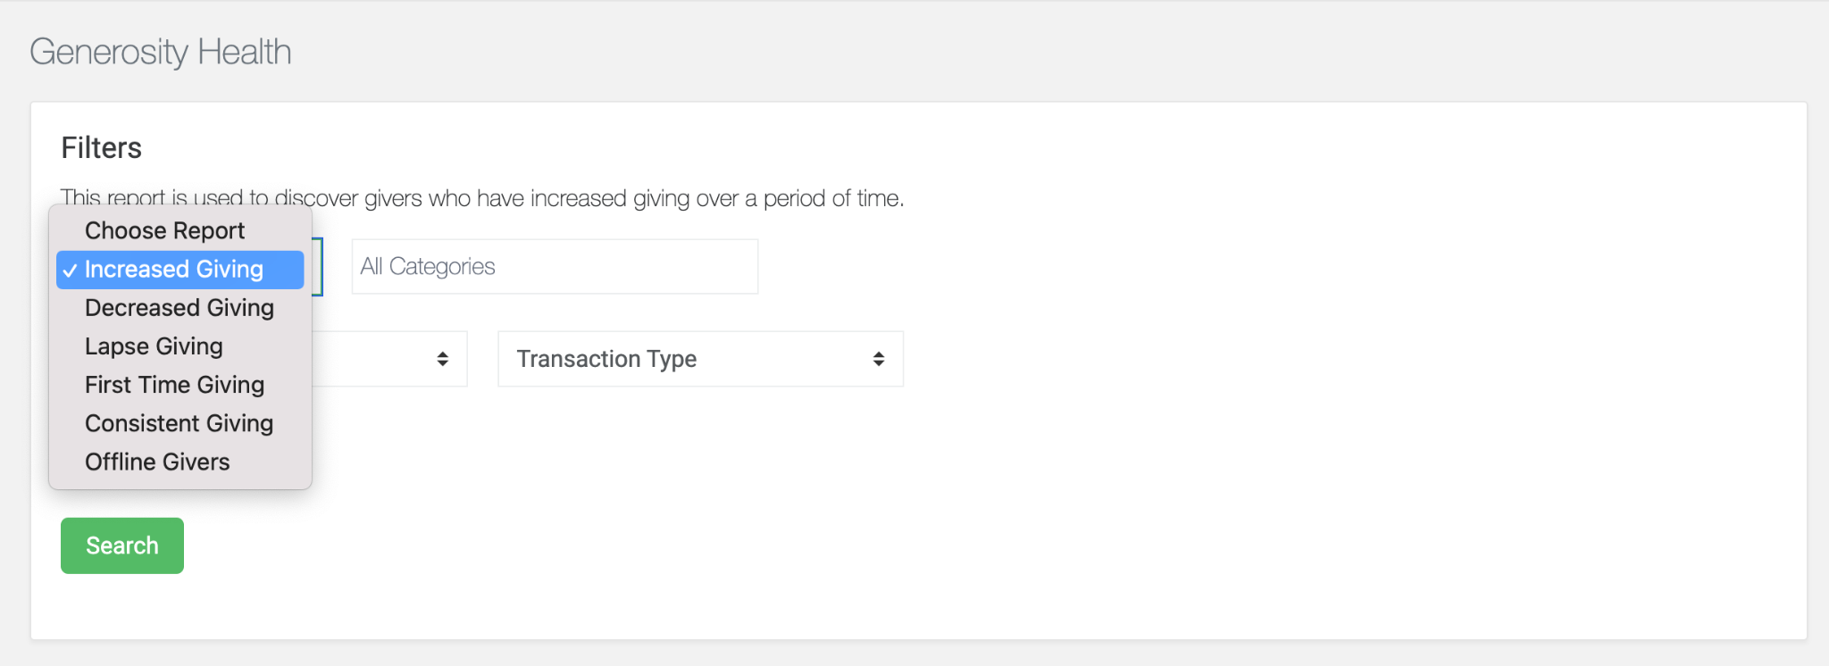
Health Checkups
*Mockup Displayed is Subject to Change

Slide 21
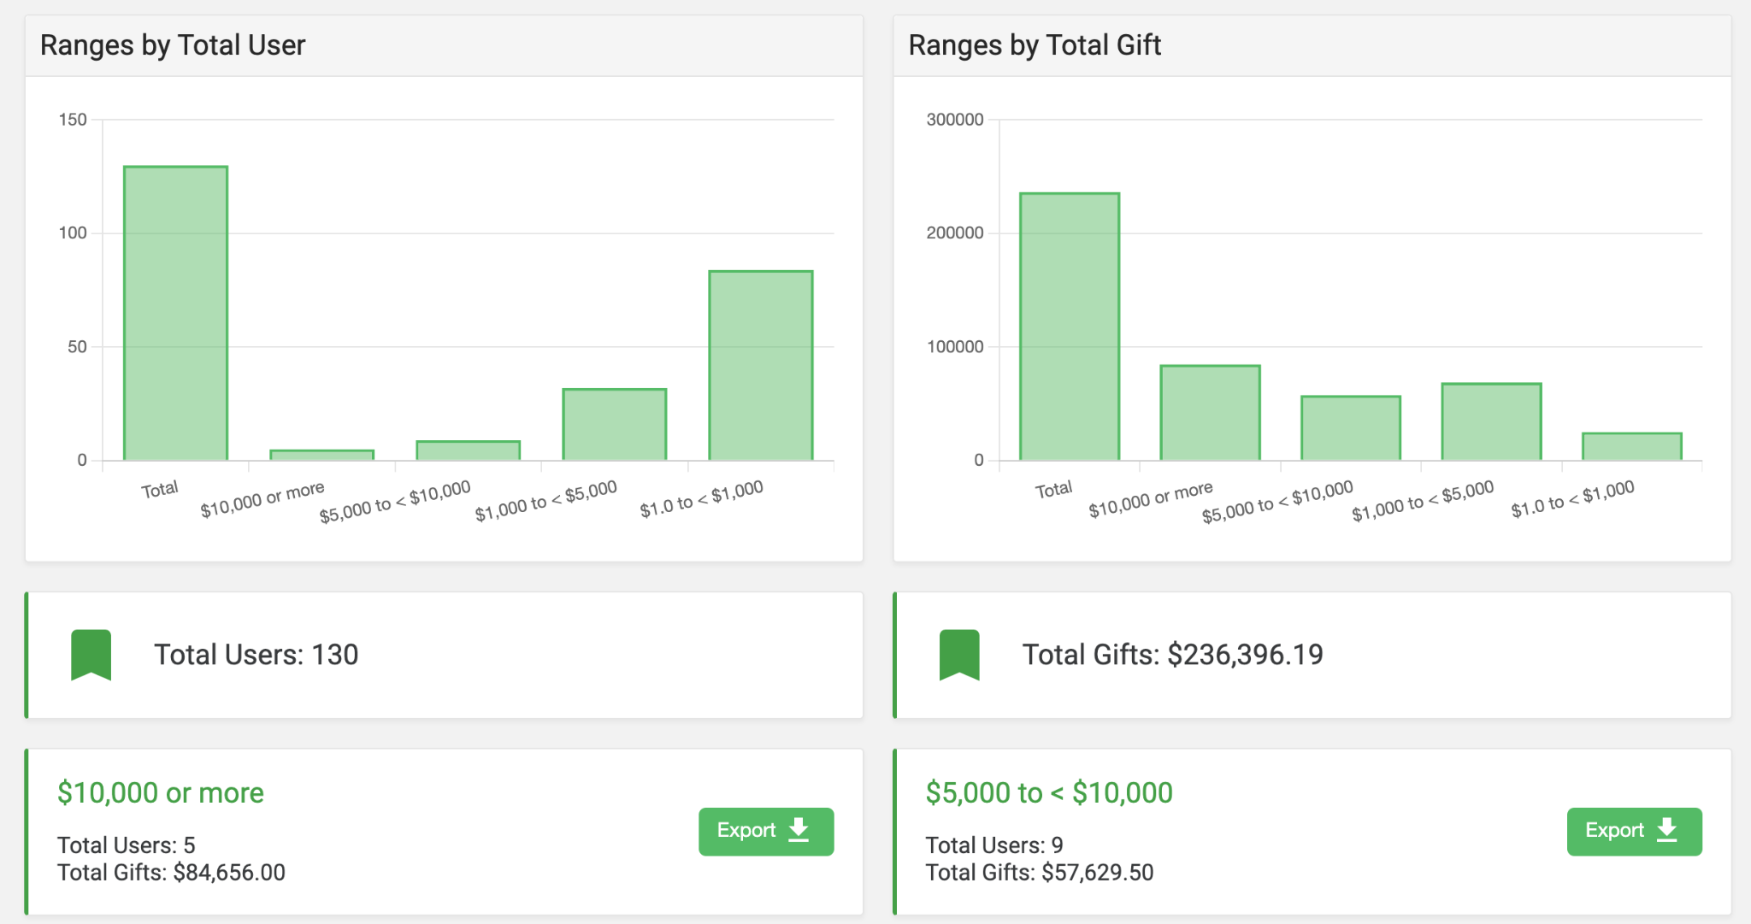
One-Click Analytics
*Mockup Displayed is Subject to Change

Slide 22
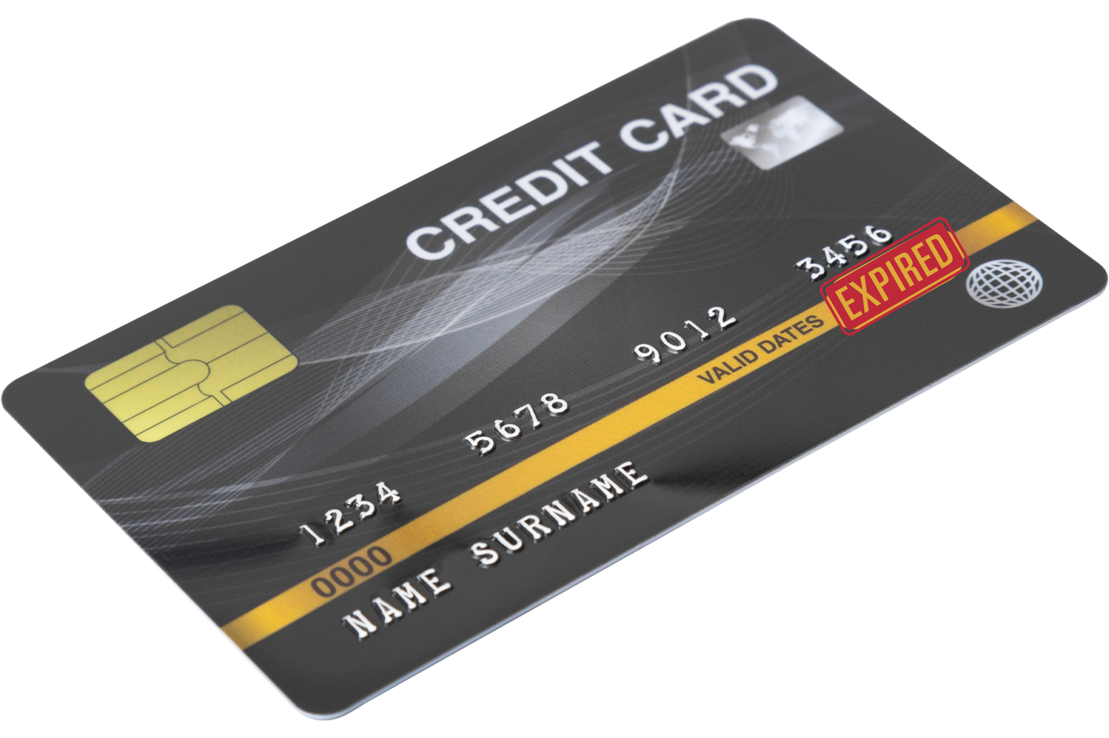
Ultra-Modern Card Updater

Slide 23
Let’s Recap
TouchPoint Giving is Live!
Want to learn more? Get in touch!
You still have options.

Slide 24
Submit Your Questions

Slide 25
Thank You!
Get In Touch!
TouchPointSoftware.com
Solutions@TouchPointSoftware.com

